Slide 1

Northeast Florida FIMR Findings
January - December 2013
Laurie Lee, RN, BSN, CCM
FIMR Coordinator

Slide 2
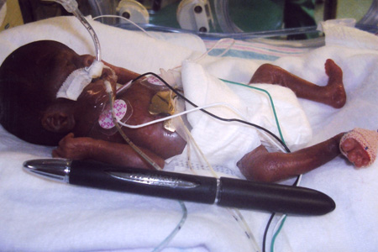
Overview of the Fetal & Infant Mortality Review Process
The FIMR Case Review Team meets 9x/year.
Review process developed by the American College of Obstetrics & Gynecology is used.
Information abstracted from birth, death, prenatal care, Healthy Start, WIC, hospital and autopsy records.
Efforts are also made to interview the family.
All information is de-identified.
Purpose is to determine specific medical, social, financial and other issues that may have impacted the poor birth outcome.
Recommendations for community action drafted annually based on findings.
Prepared by Llee
NEFL FIMR
Healthy Start Coalition

Slide 3

Overview of the Fetal & Infant Mortality Review Process
The purpose of FIMR is to examine cases with the worst outcomes to identify gaps in services that might be addressed through community action.
Cases selected for review based on specific criteria such as:
  Zip codes with high infant mortality rates
  Fetal losses over 36 weeks gestation or 2500 grams
  Deaths in outlying counties, etc.
Prepared by Llee
NEFL FIMR
Healthy Start Coalition
Notes:
Basically, we are looking for cases where we might have an impact on the outcome. Fetal deaths are “still births” that occur after 20 weeks gestation. If a baby even takes one breath or has any sign of life at delivery it is considered a “live birth”, even when death occurs within a minute.

Slide 4

Florida
Infant Mortality Rate Trends
Florida, 1990-2013
Notes:
1318 infant deaths in Florida in 2013; hispanic rate was 4.4

Slide 5
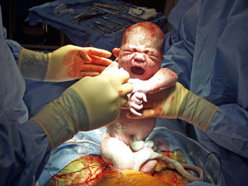
Resident Infant Mortality Rates-All Races
Northeast Florida and Florida
2004-2013
141 infant deaths in 2013
Prepared by L.Lee Source: Birth and Death Certificates/Vital Stats
Notes:
Infant deaths: Baker-5, Clay, 10, Duval-111, Nassau-1 and St. John’s w/ 14. There were a total of 256 fetal and infant deaths in NE Florida for 2013.

Slide 6
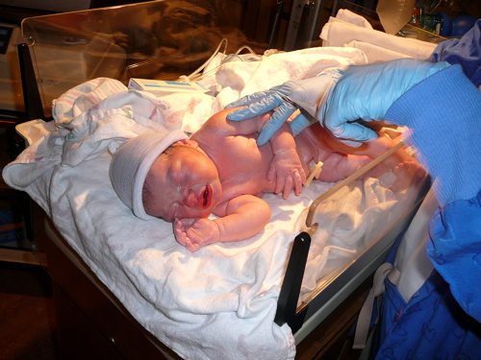
Resident White Infant Mortality Rates
Northeast Florida and Florida
2004-2013
68 white infant deaths in 2013
Prepared by L.Lee Source: Birth and Death Certificates/Vital Stats

Slide 7
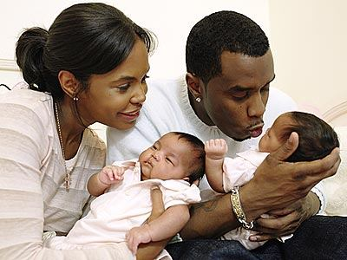
Resident Black Infant Mortality Rates
Northeast Florida and Florida
2004-2013
65 black infant deaths in 2013
Prepared by L.Lee Source: Birth and Death Certificates/Vital Stats

Slide 8
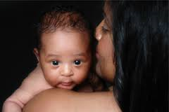
3 Year Infant Mortality Rates
All Counties
2011 – 2013
 | Infant Deaths | Births | IM Rate
Baker | 13 | 1031 | 12.6
Clay | 31 | 6258 | 5.0
Duval | 305 | 37413 | 8.2
Nassau | 10 | 2254 | 4.4
St .Johns | 23 | 5695 | 4.0
Prepared by Llee
NEFL FIMR
Healthy Start Coalition
Notes:
8
For our smaller, outlying counties, we calculate rates with at least 3 years combined because their numbers are so low. One or two deaths can really sway their rates. All four outlying counties are below state rate. For the entire death cohort (fetals and infants combined), the following trends are noted by county:
Baker-Highest in poor birth spacing; tied w/ nassau for highest substance abuse (primarily tobacco). Highest mom’s with no HS diploma. Second highest teen pregnancies. Clay-highest in single mom’s and percentage of mom’s with inadequate prenatal care. Highest hispanic rates and highest for teenage moms. Second highest mom’s with HS diploma or higher. Lowest in congenital anomalies at 33% (other 3 counties all in low 40’s). Nassau- Highest with no HS diploma (25%), Tied w/ Baker for highest substance abuse (tobacco), and highest married. More fetals than infants. St. Johns-highest white, second highest married, highest w/ some college, best in pnc, birth spacing and healthy BMI’s. Highest cocaine and marjuana use More fetals than infants. There is a 3-way tie for highest number of mom’s with unhealthy BMI’s. Baker, Clay and Nassau all have 60% while St John’s only has 47%.

Slide 9
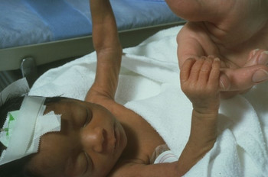
Infant Age at Death
Northeast Florida
2009-2013
Notes:
Note the increased percentage of postneonatal deaths in yellow. Sleep related deaths represent 42% of the postneonatal deaths.

Slide 10
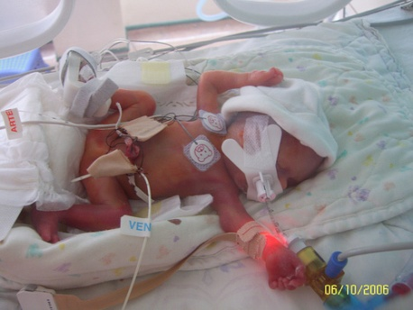
Causes of Infant Death
Northeast Florida
2013
*records may have more than one cause of death listed n=141

Slide 11

Birth Weight in Infants That Died
Northeast Florida
2013-n=141
Notes:
67% weighed less than 3.3 pounds at birth; 47% gestational age < 29 weeks; 15% previable (< 500 grams AND < 24 weeks);
14% twins or triplets.

Slide 12

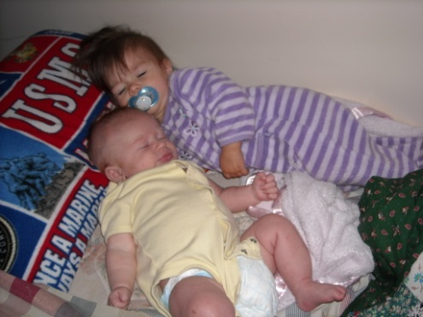
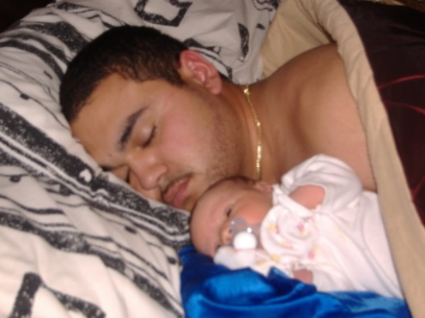

Northeast Florida
Sleep related deaths
Notes:
Note these are all examples of “unsafe” sleep.

Slide 13

Sleep Related Infant Deaths
Northeast Florida
2009 – 2013
 | 2009 | 2010 | 2011 | 2012 | 2013
# | 22 | 16 | 14 | 21 | 25
% of deaths | 15.1% | 12.6% | 12.9% | 16.5% | 17.7%
Prepared by Llee
NEFL FIMR
Healthy Start Coalition
Notes:
13

Slide 14
Distribution of Sleep Related Deaths in 2013
 | Baker | Clay | Duval | Nassau | St Johns
# deaths | 1 (Macclenny) | 2 (Fleming Island and Middleburg) | 18 | 0 | 4 (3 different zips in St. Aug; 1-Hastings
Duval county detail:
In 2013, there were 18 deaths in 14 zips. No zip with > 2. Target area had 6.
Notes:
Three zipcodes in the Target area had 1/3 of the sleep related deaths; otherwise, deaths are not concentrated in any area. The target area consists of zipcodes 32202, 32204, 32206, 32208 and 32209.

Slide 15

Risk Factor Comparison
2008-2010 + 5 cases from 2011
Risk Factor | N=70
Unsafe sleep surface | 80%
Not on back to sleep | 63%
Not in an infant bed | 70%
Never breast fed | 63%
Unsafe items in bed | 63%
Second/third hand smoke | 47%
Sharing sleep surface | 63%
Prepared by Llee
NEFL FIMR
Healthy Start Coalition
Notes:
Data above is from the All factors fairly consistent over last several years. In 2011, death scene investigation sheets were no longer available for review so we don’t have detailed information regarding risk factors. In 2012, 38% cases listed co-sleeping on death certificate as a cause of death, but we know actual number of cases where co-sleeping was present is likely higher. In 2013, co-sleeping was listed on death certificate in 44% of cases. Three additional cases specifically mentioned unsafe items in bed and or wedging so we know 56% of the 2013 cases involved unsafe sleep. In eight cases (32%), the mothers self-reported smoking which we know is under reported. This is a much higher rate of self reported smoking than what we find in the entire death cohort.

Slide 16
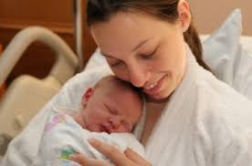
Maternal Findings
Sleep Related Deaths-2013
84% single
60% in their 20’s; 24%-30’s; 16%-teens
60% black; all others white
64% inadequate prenatal care
12 % with no high school diploma
48% are overweight or obese; only 4 of these involved co-sleeping
Notes:
There are some interesting differences from the maternal findings in the 2012 cases. In 2012, 38% had no HS diploma; now in 2013, 88% have HS diploma or higher. Seventy six percent were in their 20’s and single. Black and white were evenly split.

Slide 17


Infant Findings
Sleep Related Deaths-2013
All singletons except one twin
88% Medicaid
84% term
52% male
Notes:
Very consistent w/ 2012 findings.

Slide 18
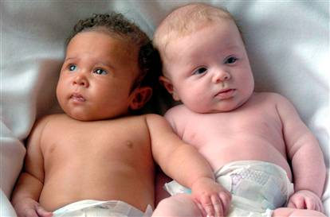
Resident Infant Mortality Rates by Race
Duval County
2009-2013
Prepared by L.Lee Source: Birth and Death Certificates/Vital stats
111 deaths:43-W; 62-B; 20-T
Notes:
Target area in 2005 was 20.1, black rate was 16.9.

Slide 19
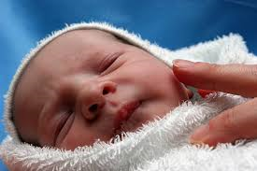
Duval County
White Births
2009-2013
Notes:
Downward trend started in 2007

Slide 20

Duval County
Black Births
2009-2013
Notes:
Downward trend began in 2007

Slide 21
Birth versus Death Cohorts: Demographics Duval County
 | Birth Cohort | Death Cohort: n=190
Race | W=56%; B=35% | W=37%; B=58%
Age | Teens trended down since 2007, currently about 7%; 20-29 year olds represent 55%; 30’s has steady increase over last 20 yrs, currently at 35%; 40+ varies, but overall, increase in last 20 years, currently at 3% | Slightly higher % of teens (8.6%) and 20’s (58%); slightly lower 30’s and 40’s (32% and <1 %, respectively).
Single Marital Status | 48% last 5 years | Had decreased from 65% to 57% last 5 years; now 70%
No HS Diploma | 13.8% | Was about 30%, now at 16.2%
Notes:
The Death Cohort is made of up all the mom’ with fetal or infant losses. We compare this to all the moms that had births to understand what the differences are between the groups.

Slide 22
Birth versus Death Cohorts: Behavior
Duval County
 | Birth Cohort | Death Cohort
Smoking | 6.9% | Was trending down 17 – 12% over last 4 yrs; now 15%
Overweight/Obese BMI | 50.3% | 42.8% (plus 8% underweight)
Inadequate prenatal care | 28.2% | Was trending down over last 5 yrs-40 to 33%; now at 36%
Pregnancy Interval < 12 mos | State tracks < 18 mos; now 39.5% | Was trending down 22-14% last 6 years; now 20%

Slide 23
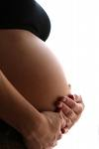
Contributing Factors in FIMR Cases
2011-2013
N=81
79% all FIMR cases had medical history issues
Notes:
When we deliberate FIMR cases, we determine strengths, information source issues, contributing factors and strengths. The contributing factors really help us understand where the opportunities to impact outcomes are.

Slide 24


Contributing Factors in FIMR Cases
2011-2013
N=81
Prepared by L.Lee Source: FIMR/CRT case reviews

Slide 25
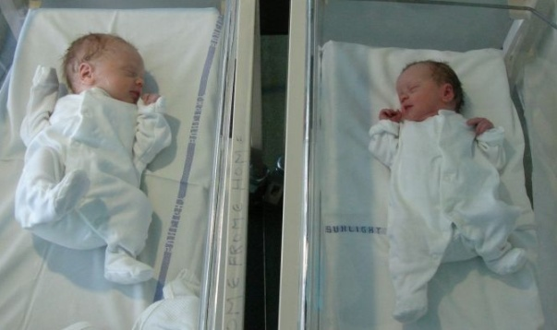
Contributing Factors in FIMR Cases
2011-2013
N=81
Prepared by L.Lee Source: FIMR/CRT case reviews
Prepared by L.Lee Source: FIMR/CRT case reviews
Notes:
The life course approach to conceptualizing health care needs and services evolved from research documenting the important role early life events play in shaping an individual’s health trajectory. The interplay of risk and protective factors, such as socioeconomic status, toxic environmental exposures, health behaviors, stress, and nutrition, influence health throughout one’s lifetime. Based on maternal child research findings, we began including life course perspective issues in our data gathering for FIMR several years ago. Examples include growing up in an single parent household, abuse of any type, lack of healthcare, growing up in poverty, etc.

Slide 26
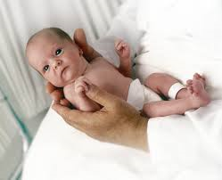
Contributing Factors in FIMR Cases
2011-2013
N=81
Prepared by L.Lee Source: FIMR/CRT case reviews
Prepared by L.Lee Source: FIMR/CRT case reviews
Notes:
PROM, Anemia, STD’s and Placental Abruptions occurred in about ¼ of the FIMR cases. STD’s had been on rise in FIMR cases, but now trending downward 2 years in a row.

Slide 27

Contributing Factors in FIMR Cases
2011-2013
N=81
Prepared by L.Lee Source: FIMR/CRT case reviews
Prepared by L.Lee Source: FIMR/CRT case reviews
Notes:
For prenatal care, we follow the ACOG recommendations. We are looking for the client to start care in the first trimester, and have the recommended number of visits based on the number of weeks the pregnancy lasts. Clients should have 1 visit a month through 28 weeks, then visits every 2 weeks through 36 weeks, then weekly visits. Obviously high risk pregnancies require more, but we are looking for this baseline to be met. Family planning includes birth spacing and whether or not pregnancy was planned, unplanned or undesired.

Slide 28

Contributing Factors in FIMR Cases
2011-2013
N=81
Prepared by L.Lee Source: FIMR/CRT case reviews
Prepared by L.Lee Source: FIMR/CRT case reviews

Slide 29
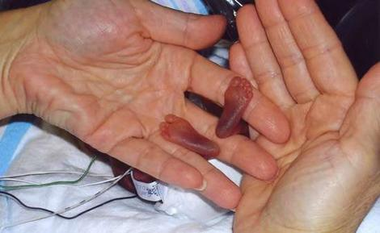
Contributing Factors in FIMR Cases
2011-2013
N=81
Prepared by L.Lee Source: FIMR/CRT case reviews
Prepared by L.Lee Source: FIMR/CRT case reviews
Notes:
Be mindful that COD of prematurity does not apply to fetal deaths; nearly all infant deaths reviewed had prematurity identified as contributing factor.

Slide 30

2014 FIMR Recommendations
(based on 2013 data)
Continue to focus on preventing sleep related deaths.
  The number of sleep related deaths has increased over the last 3 years. The number of deaths for years 2011, 2012 and 2013 were 14, 21 and 25 respectively. When compared to all causes of death in infants for years 2011, 2012 and 2013, this represents 13%, 16.5%, and 18%, respectively.
  Education should focus on babies sleeping alone on a safe sleep surface.

Slide 31
2014 FIMR Recommendations
(based on 2013 data)
The following are potential partners:
  Healthy Mothers Healthy Babies to revive the Cribs 4 Kids programs
  Americorp
  Faith based organizations for “Safe Sleep Sundays”
  Make a Noise, Make a Difference
    Curriculum for health advisors
  Baptist Community Health
    Video link
  Safe Kids Coalition
  National SIDS Foundation
    Free educational materials
  WIC
    Include safe sleep in breast feeding courses
  CDC
    Video to use in educational settings
  City Match
    LifeCourse board game
  The Players Center For Child Health at Wolfson Children’s Hospital- Ready, Set Sleep program

Slide 32
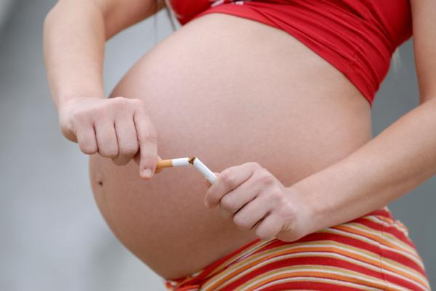
2014 FIMR Recommendations
(based on 2013 data)
Continue to focus on dangers of smoking during pregnancy.
  The Community Action Team’s “Don’t Blow Smoke” campaign is gaining momentum.
    Phase I (target area-Health Zone 1)
    Phase 2 (social media and expansion outside the target area to include the 32218 and 32244 zip codes) have been implemented.
  The percentage of moms in the death cohort that self-reported tobacco use was 12% in 2012. It rose to 15% in 2013. Self-reported tobacco use in the 2013 birth cohort is 6.9%.

Slide 33

Thank you!
Any questions?

