Slide 1
The Affordable Care Act’s Impact on Maternal and Child Health
Healthy Start Coalition of Manatee County May 17, 2013
Leah Barber-Heinz
Advocacy Director

Slide 2
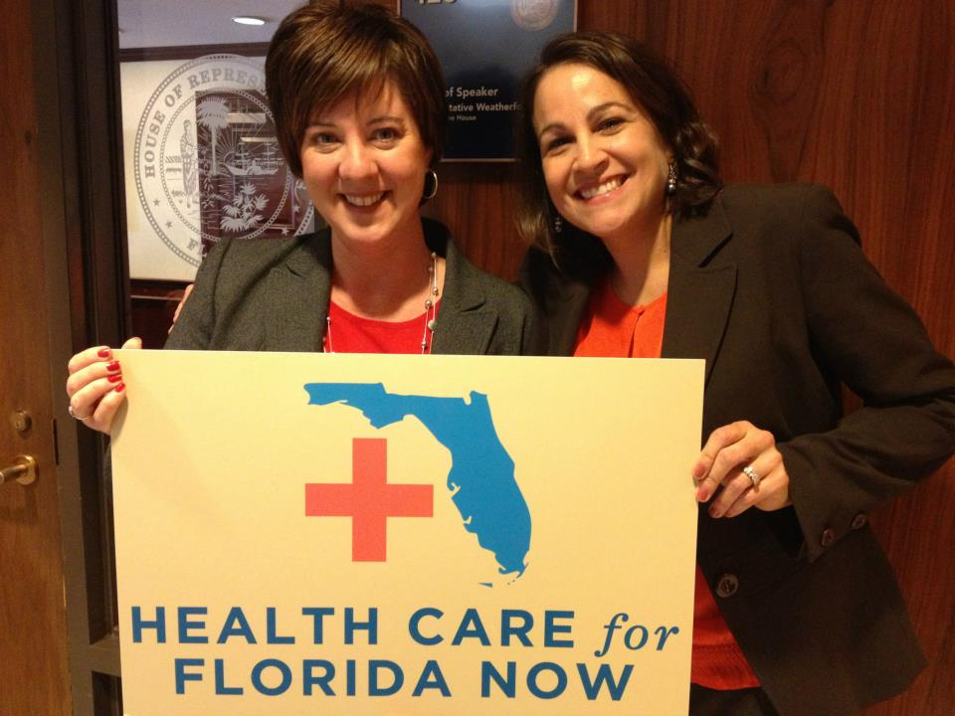
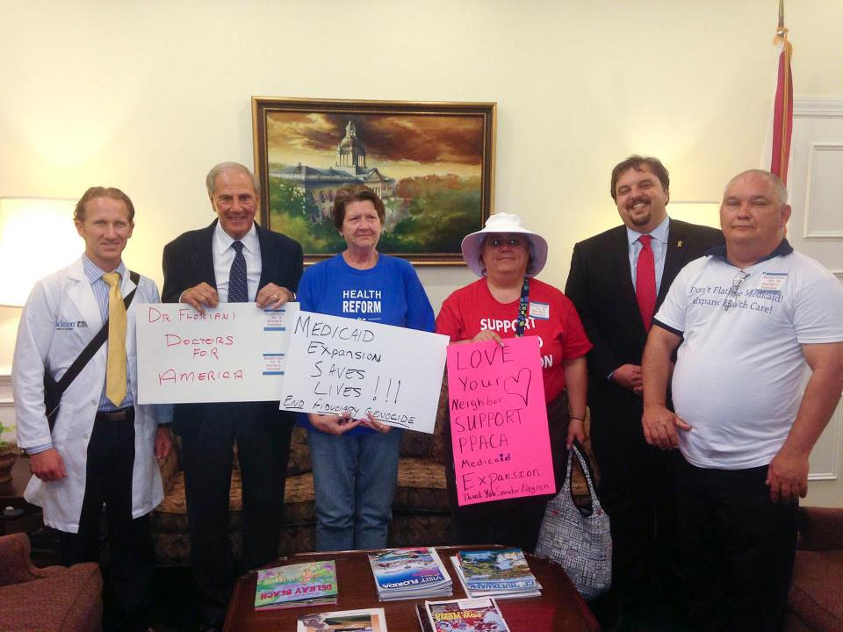
Who is Florida CHAIN?
Organize people, doctors, patients, and community groups to improve access to healthcare in Florida Medicaid Medicare Health Care Reform KidCare Staff of 5 in Palm Beach, Broward, Orlando, Tampa, St. Pete non-profit

Slide 3
Women and the ACA: Why This is Important
The health care law, known as the Affordable Care Act (ACA), protects women from discriminatory health insurance practices such as gender rating, makes health coverage more affordable and easier to obtain, and improves access to many of the health services women need.

Slide 4
Why This is Very Important
In 2008, one in four women went without necessary health care because they could not afford it.
The Department of Labor estimates that women make approximately 80% of health care decisions for their family.
Traditionally, health insurance plans sold in the individual market have failed to provide comprehensive maternity services; in 2009 only 13% of plans sold in the individual market included comprehensive maternity coverage.
Notes:
From report on No Where to Turn

Slide 5
Why This is Very Important
Historically, women in the majority of states have been charged more for health insurance than men—a practice known as gender rating.
Women have historically had more difficulty than men affording health insurance coverage and delaying preventive care and treatment due to costs.

Slide 6
What Does this Mean for Florida? Snapshot of Uninsured Women in Florida
The most recent data demonstrates that approximately 2 million women in Florida are uninsured; 30,000 uninsured females living in Manatee County.
The majority of uninsured women in Florida are below 200% of the federal poverty line (FPL), just $21,780 annually for an individual and roughly $37,000 for a family of three.

Slide 7
Racial and Ethnic Health Disparities in Florida
There is a significant disparity of insurance rates among communities of color in Florida; 38% of Hispanic women and 31% of Black women are uninsured compared to 18% of White women.
2nd highest number of women and girls with AIDS in the U.S.; 70% are African-American
Birth outcomes: African-American babies die at a much higher rate than White babies

Slide 8
Affordable Care Act Primary Goals
Provide affordable quality health coverage that is easily available and reform unfair insurance practices
Creates Health Insurance Marketplaces (AKA Exchanges)
Opportunity to Expand Medicaid
Strengthens Medicare
Reforms Private Health Insurance Market
Protects Consumers

Slide 9
ACA Reforms Already in Place
Ban on cancelling coverage
Ban on denials of kids with pre-existing conditions
Eliminate lifetime limits
Remain on parents coverage until 26
Prohibitions on discrimination
Closing the “donut hole”
Providing preventive services at no additional cost
Small business tax credits
Pre-Existing Condition Insurance Plans
Greater transparency for premium rate review
Requirements on Medical Loss Ratio

Slide 10
Top Things to Know for Pregnant Women
Job-based health plans and new individual plans are no longer allowed to deny or exclude coverage to your baby (or any child under age 19) based on health conditions, including babies born with health problems.
New health plans must now cover certain preventive services without cost sharing.
Starting in 2014, essential health benefits such as pregnancy and newborn care, along with vision and dental care for children, will be covered in all new individual, small business and Marketplace plans.

Slide 11
Top Things to Know for Pregnant Women
Starting in 2014, job-based health plans and new individual plans won’t be allowed to deny or exclude anyone or charge more for a pre-existing condition, including pregnancy or a disability.
In 2014, if your income is less than the equivalent of about $88,000 for a family of four today and your job doesn’t offer affordable coverage, you may get tax credits to help pay for insurance.

Slide 12
Health Insurance Marketplace
Pooling to combine risk among larger populations
Single streamlined application; no wrong door policy
Screened for Medicaid, CHIP and premium tax credits in real time
Choice of plan options at different levels and cost sharing
Provides apples to apples comparison of insurance plans
Offers tax credits/subsidies: From 100 to 400% Federal Poverty Level, 89,400 for a family of four
Notes:
Currently poverty level 22,350 for a family of four.

Slide 13
Essential Health Benefits
Starting in 2014, all new health plans must cover a list essential health benefits including maternity and newborn care, (without limits) and mental health treatment

Slide 14
Essential Health Benefits
Ambulatory patient services
Emergency services
Hospitalization
Laboratory services
Pediatric services, including oral and vision care.
Prescription drugs
Preventive and wellness services and chronic disease management
Rehabilitative and habilitative services and devices

Slide 15
Women’s Preventive Health Services
All new insurance plans are required to provide the following services with no copayments, deductibles or co-insurance:
The full range of FDA-approved contraception methods and contraceptive counseling
Well-woman visits
Screening for gestational diabetes
Human papillomavirus (HPV) DNA testing for women > 30 years
Sexually-transmitted infection counseling
Human immunodeficiency virus (HIV) screening and counseling;
Breastfeeding support, supplies, and counseling
Domestic violence screening and counseling
Notes:
Most plans will likely begin this in Jan 2013
Grandfathered and ungrandfathered

Slide 16
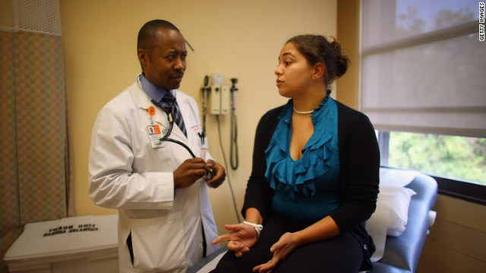
How does the law address health disparities and discrimination?
Preventive care
Coordinated care
Diversity and cultural
competency
Health care providers for underserved communities
Ending insurance discrimination
Affordable insurance coverage

Slide 17
Medicaid Expansion: Health Care for Florida Now
Became optional when the U. S. Supreme Court ruled last June
Florida has the unique opportunity to draw down $51 billion to insure 1.2 million working Floridians (up to 138% FPL) and create 120,000 private-sector jobs
The federal government will pay 100 percent of the costs from 2014 to 2016; and down to 90 percent by 2020
It estimated that 641,178 or 68% of uninsured women in Florida would gain coverage under the expansion
Under 100% not eligible for the Marketplace; 700,000 total “left out in the cold”

Slide 18
What’s Next?
Public Education on Enrollment into the Marketplace/Navigators
Continued Efforts to Expand Medicaid

Slide 19
Thank you!
leahb@floridachain.org
www.floridachain.org www.healthcare.gov
www.healthcareforflorida.org
FloridaCHAIN #FLCHAIN

