Slide 1
Florida Health Insurance Marketplace
Introduction/General Information

Slide 2
Snapshot: United States, 2010
World Health Organization:
U.S. ranked 37th of the world’s major health systems
14th in preventable deaths
72nd in health systems performance
2nd in total healthcare expenditures

Slide 3
Mortality Amenable to Health Care
Deaths per 100,000 population*

Slide 4
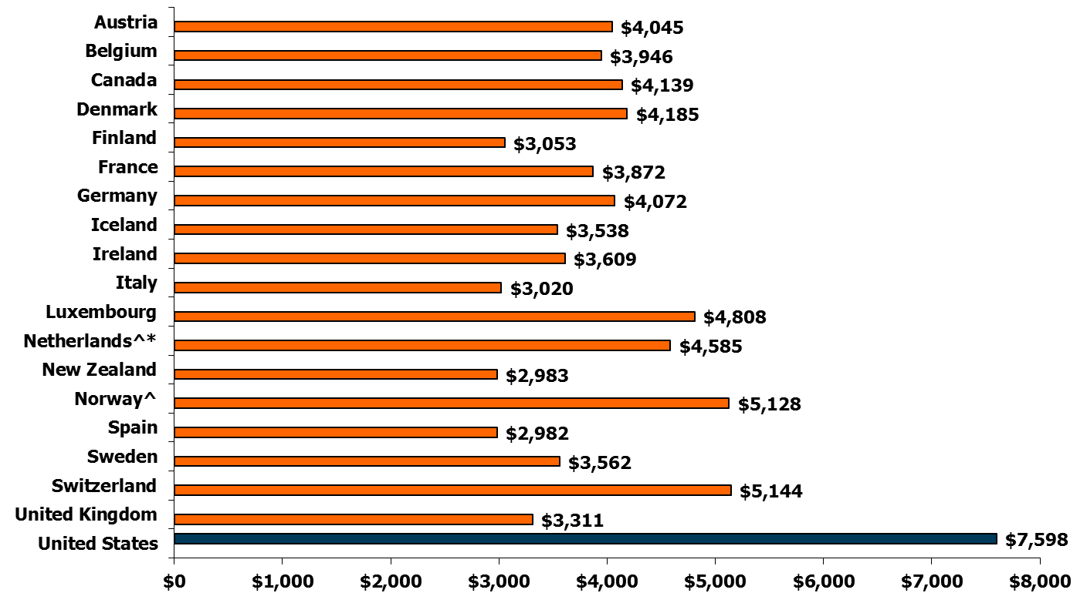
Per Capita Total Current Health Care Expenditures, U.S. and Selected Countries, 2009
Notes:
4

Slide 5
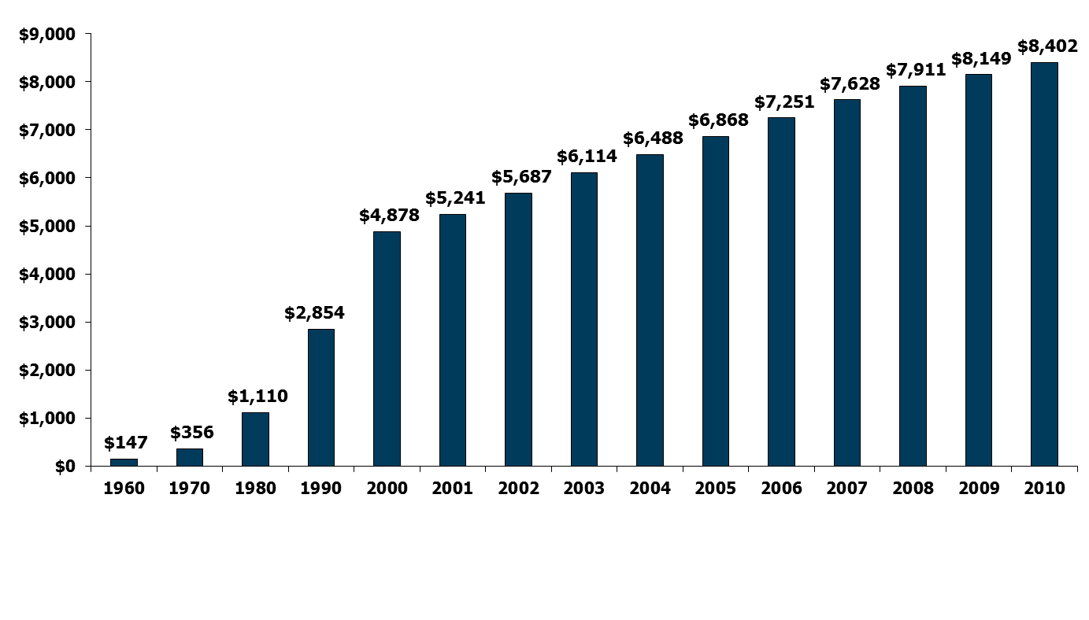
National Health Expenditures per Capita, 1960-2010
NHE as a Share of GDP
5.2% 7.2% 9.2% 12.5% 13.8% 14.5% 15.4% 15.9% 16.0% 16.1% 16.2% 16.4% 16.8% 17.9% 17.9%
Notes: According to CMS, population is the U.S. Bureau of the Census resident-based population, less armed forces overseas.
Source: Centers for Medicare and Medicaid Services, Office of the Actuary, National Health Statistics Group, at http://www.cms.hhs.gov/NationalHealthExpendData/ (see Historical; NHE summary including share of GDP, CY 1960-2010; file nhegdp10.zip).
Notes:
Focus on “Share of GDP”…. In 2010 – 17.9% of the country’s GDP was healthcare related – equating that healthcare comprises nearly 1/5 of the US economy.

Slide 6
Uninsured in the U.S.
Millions of uninsured
Source: Income, Poverty, and Health Insurance Coverage in the United States: 2010 (Washington, D.C.: U.S. Census Bureau, Sept. 2011).
Notes:
Not shown – employees of small businesses are often “under-insured” – with very high monthly premiums, copays, and other out of pocket costs that they may not be able to afford. Many may also be covered as individuals, but cannot afford the additional cost family coverage for dependents.

Slide 7
Patient Protection and Affordable Care Act (PPACA)
Federal statute signed into Law on 3/23/10
Primary Aims:
Increase the number of Americans with health coverage
Reduce the overall costs of healthcare in the U.S.
Multiple provisions or “Reforms”
Implementation steps began in 2010
Full implementation by January 1, 2014

Slide 8
4 Reform Categories
Consumer Rights/ Protections
Stop/limit pre-existing exclusions
Affordable Coverage
Medical Loss Ratio (80/20 Rule)
Better
Access
Free Prevention benefits
Stronger
Medicare
Lower cost prescription medications
Eliminates lifetime coverage limits
Prohibits coverage cancellations
Stops unreasonable rate increases
Small business tax credits
Coverage for young adults
Affordable insurance exchanges
Improved care/quality
Free preventative services
Identifying Medicare fraud/abuse

Slide 9
Implementation in Florida
Some patient protections have already begun:
Small business tax credits for offering employee coverage
No-cost preventative health services
No Pre-Existing coverage denials for children and PCIP’s
Tax credits to seniors in the Medicare “donut hole”
Preventing Rescinded Coverage due to errors
Process to appeal insurance company decisions/denials
“80/20” Rule
Extended coverage for young adults up to Age 26
Increased reimbursement for rural/underserved providers
Coverage for All (aka. Medicaid Expansion) - No expansion in FL
Health Insurance Exchange Marketplace – Coming October 2013

Slide 10
Small Business Tax Credits
Phase 1 – credit up to 35% of employer contribution for employee coverage for most small businesses (25% for non-profits)
Fewer than 25 employees
Began in Jan. 1 2010, increases in 2014
Up to 50%
Up to 35% for non-profits

Slide 11
No-Cost Preventative Healthcare
Began September 23, 2010 (applied to new plans)
No copays or deductibles for proven preventative services and screenings
Well-child visits
PAP smears and mammograms
Colonoscopy and other cancer screening
Diabetes screening
Blood pressure monitoring
Flu shots
Others…

Slide 12
Coverage for Pre-Existing Conditions
As of August 2012 – special Pre-Existing Condition Insurance Plan (PCIP) availability
$2,000 annual medical deductible
$500 annual prescription drug deductible
30% of medical costs in-network
Max Out-of-Pocket of $6,250/yr for covered services in-network
Children under age 19 cannot be excluded from any new pan (after 9/23/10) for pre-existing
Standard Plan Premium Levels
Age | Monthly Premium
0-18 | $136
19-34 | $202
35-44 | $243
45-54 | $311
55+ | $432

Slide 13
Closing the Medicare “Donut Hole”
For Medicare Part D beneficiaries, who do not receive “extra help”
Gradual close beginning in 2010 thru 2020
Available now:
Some coverage for some medications
Discounts on covered meds purchased at pharmacies or via mail-order (up to 50%)

Slide 14
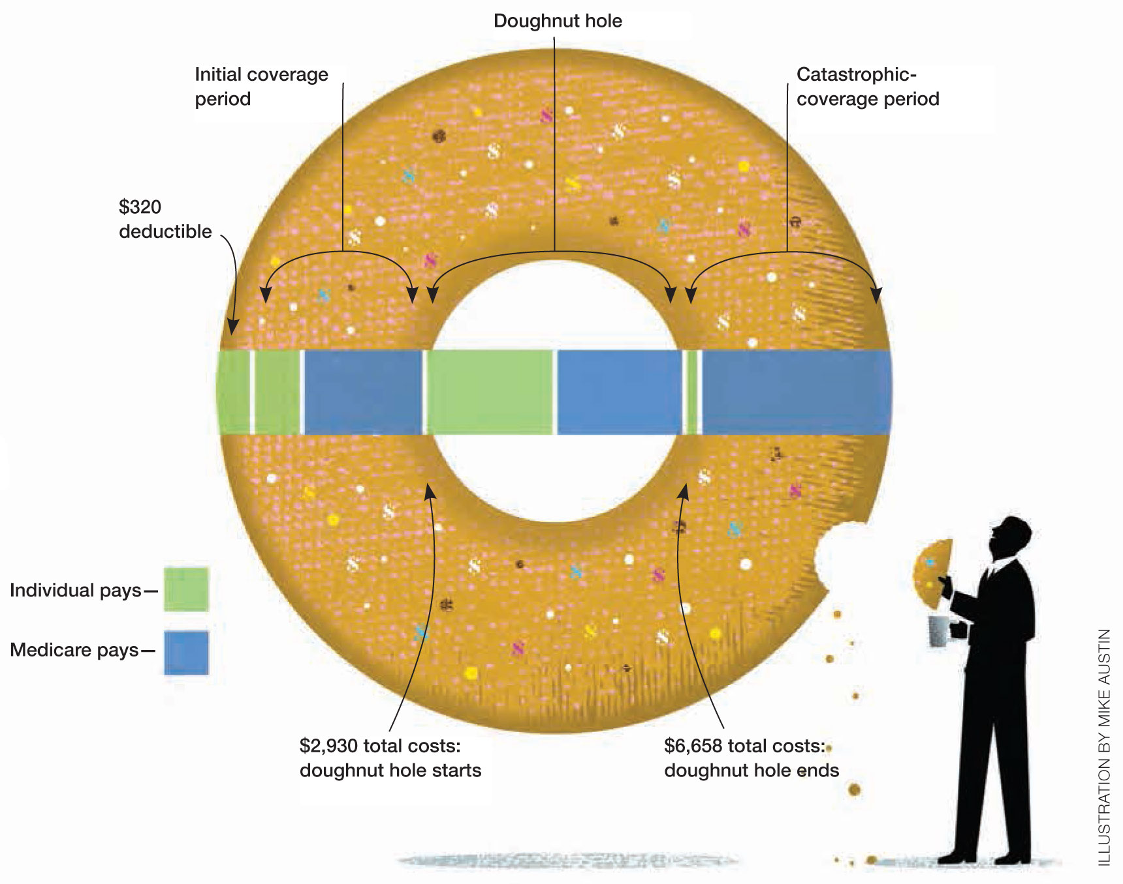

Slide 15
Extended coverage for young adults
Adults can remain on a parent’s plan until age 26 (some limitations on existing group plans*)
Even adults who are:
Married
Not living with the parent
Attending school
Not financially dependent on the parent
Eligible to enroll in their own employer’s plan at work*

Slide 16
The “80/20” Rule
Medical Loss Ratio (MLR)
A minimum of 80% (small groups) to 85% (large groups) of all premiums must be spent on medical care and/or the improvement of medical care
A maximum of 20% (or 15%) may be spent on administrative overhead and marketing
Insurance companies must provide premium rebates if the ratio is not met annually

Slide 17
What’s still coming…
Regulation of annual limits and lifetime limits
Health Insurance Exchange/Marketplaces
Linking payment to quality and outcomes
Increasing reimbursement for primary care

Slide 18
• Coverage to fit individual needs
New premium tax credit (sliding scale for 138-400%FPL)
Advance payment of the premium tax credit to the health plan to help lower monthly premiums
• Unbiased help and customer support
• Quality health coverage w/ minimum standards
“Apples to Apples” comparison in simple terms
• Easy to use

Slide 19
How the Marketplace Works
One process to determine eligibility for:
Qualified Health Plan on the Marketplace
New tax credits to lower premiums
Reduced cost sharing
Medicaid (Assmnt. only in FL)
Children’s Health Insurance Program (CHIP)
Offers choice of plans w/ 4 levels of coverage
Insurance companies compete for business

Slide 20
Premium Tax Credits
400% FPL
100% FPL
Up to $45,960 for individuals
Up to $62,040 for a family of 2
Up to $78,120 for a family of 3
Up to $94,200 for a family of 4
Up to $110,280 for a family of 5
Up to $126,360 for a family of 6
Up to $142,440 for a family of 7
Up to $158,520 for a family of 8

Slide 21
Cost Sharing
250% FPL
100% FPL
Up to $28,725 for individuals
Up to $38,775 for a family of 2
Up to $48,825 for a family of 3
Up to $58,875 for a family of 4
Up to $68,925 for a family of 5
Up to $78,975 for a family of 6
Up to $89,025 for a family of 7
Up to $99,075 for a family of 8

Slide 22
QHP Basics
A Qualified Health Plan
Is offered by an issuer licensed in the state
Covers “Essential Health Benefits”
Offers at least 2 plan tiers (silver and gold)
Agrees to charge the same premium rate whether offered directly through Marketplace or outside the Marketplace

Slide 23
Coverage Levels
Essential Health Benefits
Ambulatory
Patient Services
Prescription
Drugs
Emergency
Services
Hab/Rehab
Services
Hospitalization
Lab Services
Maternity & Newborn Care
Prev/Wellness & Chronic Disease Management
Behavioral
Health
Pediatric
Oral/Vision Care
Four Levels of coverage to choose from…
Plan Level | Plan Pays (Avg) | Patient Pays* (Avg)
Bronze | 60% | 40%
Silver | 70% | 30%
Gold | 80% | 20%
Platinum | 90% | 10%
* In addition to regular monthly premium

Slide 24
Insurance Marketplace Eligibility
Live in service area (Florida)
U.S. Citizen or National… OR…
Non-Citizen lawfully present in the U.S. for the entire period for which enrollment is sought
Not be incarcerated (Can apply for Medicaid at any time)

Slide 25
Potential Gap in Florida

Slide 26
Florida Medicaid Eligibility

Slide 27
Open Enrollment
October 1, 2013 – March 31, 2014
Enrollment Date | Coverage Effective Date
On or before December 15, 2013 | January 1, 2014
1st – 15th Day of January, February, or March | 1st Day of following month
16th – Last Day of January, February, or March | First Day of the second following month
Annual Open Enrollment for all following years:
October 15 – December 7

Slide 28
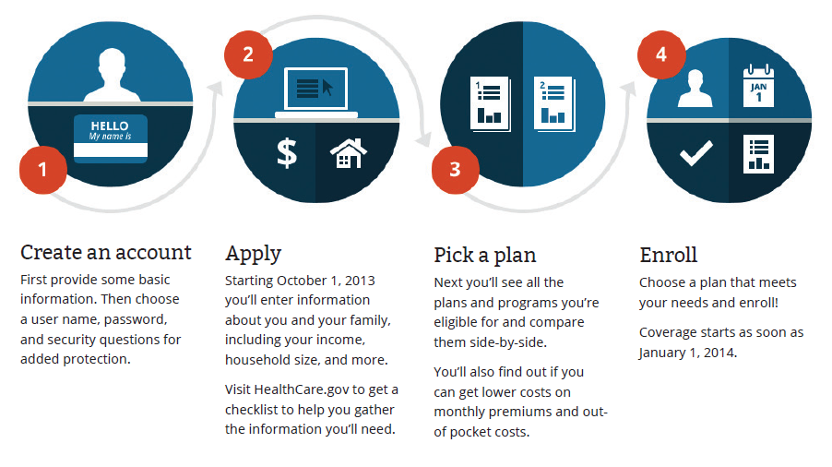
How the Marketplace Works

Slide 29
Help for Consumers
Online:
Telephone: 1-800-318-2596
In-person:
Navigators and Assisters…
Certified Application Counselors
Agents and Brokers
Other Champions and Assisters

Slide 30
Resources to Help
Get official resources, training and materials at: Marketplace.CMS.gov
Regulatory Information and Guidance: www.cms.gov/CCIIO
Florida Office of Insurance Regulation: www.FLOIR.com

Slide 31
Resources in NE Florida
Navigators
FQHC’s
CAC’s
Enroll America
Florida CHAIN
Elected officials
WJCT
Libraries
NonProfit Center
Chamber
Uninsured Workgroup

Slide 32
Thank You
Nikole Helvey, MS HSA
Nikole_Helvey@hpcnef.org

