Slide 1



Early Elective Delivery:
Probing the Perspectives of Men and Hispanics of Childbearing Age in Florida
Wendy Struchen-Shellhorn
St. Petersburg College
Carol Brady
Florida Assoc. of Healthy Start Coalitions, Inc. (FAHSC)
Sara Reiger
NE Florida Healthy Start Coalition, Inc.

Slide 2
PROBLEM
Increase in elective deliveries at 37-39 weeks
U.S. induction rates doubled⁺ in past decade
    Majority are non-medically indicated
    C-sections & late pre-term births
Misconceptions about:
  Value of the last few weeks of pregnancy
  Term gestation and gestational age for safe delivery
Martin J.A., Hamilton B.E., Sutton P.D., & Vendura S.J. (2007). Births: Final data for 2006. National Vital Statistics Report. 57(7).
Signore C. (2010). No time for complacency: Labor inductions, cesarean deliveries, and the definition of “Term”. American Journal of Obstetrics and Gynecology, 116(1), 4-6.
Zhang X., Joseph K.S., & Kramer MS. (2010). Decreased term and post-term birth weight in the United States: Impact of labor induction. American Journal of Obstetrics and Gynecology, 203(124), e1-7.G.
March of Dimes (2010). Elimination of non-medically indicated elective delivery: Quality improvement toolkit.

Slide 3
Background:
2011: March of Dimes and FAHSC
3-yr Campaign: Awareness & Education
Purpose of Overall Project:
  Develop increase consumer knowledge about the importance of the last weeks of pregnancy.
Purpose of the Focus Groups:
  Learn how to develop effective education and awareness materials for Hispanics and men.

Slide 4

http://www.39weeksfl.com/
Issues:
  South Florida:
    High rates of elective inductions
    Large Hispanic population
  Fathers omitted from education and awareness efforts.

Slide 5
Participants:
- 8 Focus Groups in 5 Counties
- 34 women and 29 men
- Demographics
  Varied
- age,
- on whether they had a child
- were having a baby
- age of any children
- Race/Ethnicity:
- Hispanic and a blend of Hispanic, African American or both

Slide 6
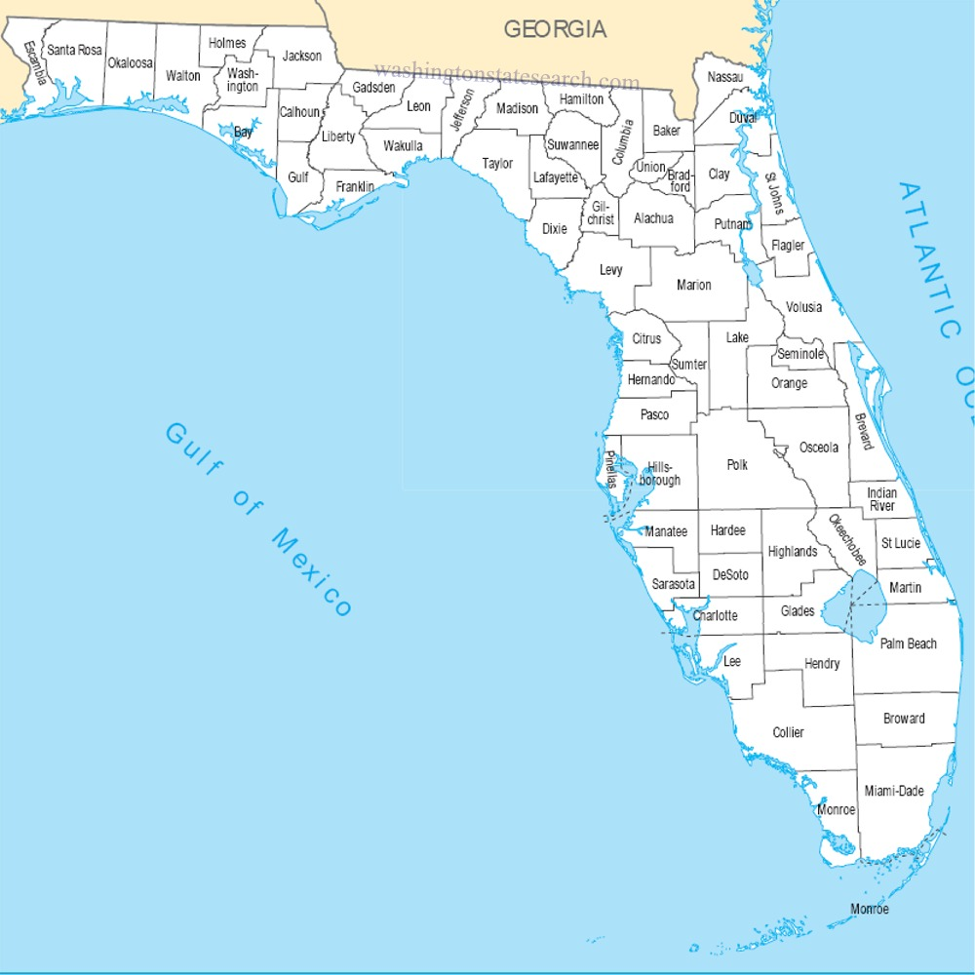
Geography of Focus Groups:
Broward
Hillsborough
Orange
Miami-Dade
West Palm Beach

Slide 7

Turn Back Time
Transformation of the Pregnancy Experience:

Slide 8

50 Years Ago:
No pregnant women on TV
Later awareness of pregnancy
No sonograms/ultrasounds
Women saw OB & delivered alone
Fewer working mothers

Slide 9
Transformation: Today
Connected to baby more/longer:
  Pregnancy known in days (longer pregnancy)
  Ultrasounds & 3-D sonograms
Mothers juggling jobs, other children, etc.
Overwhelmed by unsolicited messages
Tax babies / School babies

Slide 10

Transformation (continued)
Expected to post regularly on Social Media
Expanded family delivery rooms
Video of the birthing experience
Family/friends want deliveries scheduled at convenient times

Slide 11


Pregnancy:
A Multi-Billion Dollar Industry
I Dream of Sushi Labor & Delivery Gown
Pretty Pushers Disposable Delivery/Labor Gown

Slide 12
Bombarded with Messages
“I think all the stories…you are like OMG!...you don’t know who to listen to. I want fish. Can I eat fish? You don’t know what to do.”
“[My] mother urged scheduling the birth on her birthday.” (3 months into pregnancy)
“When you get info from too many sources I think it can be overwhelming and you get confused. You have to keep asking because your doctor who is following your pregnancy. You combine what you read and then ask what it means.”

Slide 13
Provider Trust
Encouraging elective early delivery could harm patient-provider relationship
“It’s scary when you are hearing the percentage of doctors that are scheduling for certain reasons, pushing C-sections. You want to trust in your doctor.”
“I don’t get it. I don’t understand these doctors, ‘Oh I’m going on vacation so we are going to do your C-section tomorrow’ or ‘we are going to induce you this day.’ ”
“My wife …felt very pressured… [by doctor to schedule c-section]... he gave some justification and it’s our first kid he is the expert not me.”

Slide 14
Provider Communication:
If they don’t get information there,
they will get it elsewhere.
“I had installed the App on my phone it said by this time you should already have an ultrasound.
I was so worried my ultrasound wasn’t till next month and then the doctor is like don’t trust everything you read.
…I went to a nursing school and that’s when I had it.
I didn’t tell my doctor … I didn’t want her to feel bad”

Slide 15
The Role of the Father
Dads want to be more involved
but are often over-ridden:
“Ultimately you don’t really have a choice – it is whatever she wants to do. At the end of the pregnancy as the thought process follows through you might say hey I would like you to do this but she talks to doctor, talks to her friends and friends say well girl I did it this way so you should do it this was cause this way is easier for me then next thing you know that’s the way they go.”

Slide 16
Support Systems:
Beyond the Baby’s Father
Women want supports but
It does not HAVE be the baby’s father
  especially among millenials.
“I think support is important from anyone…it’s good to know there’s someone there by your side holding your hand telling you hey you’re superwoman.”

Slide 17
Cultural Considerations
Family, especially mothers, are influential
Maternal culture and experiences
Absent family supports (immigrants)
“In our country it is so common (Paraguay)-to have your baby scheduled C-section .”
“I think it is more of a cultural thing… I guess the majority of Spanish people think its a very natural procedure that needs to be done.”

Slide 18
Conflicting Information
“Once it started getting close [we asked] when is it ok and we don’t have to worry about him being preemie they told us 36…That’s what we went with.”
People are told after 36 weeks is OK for the baby.
Then–why not take advantage of the convenience
Today’s schedules are busier than ever:
*Family/social support *Jobs
*Other Children *Vacation Time

Slide 19
Scheduling Convenience:
A real issue needing recognition!
“So the baby is due around this time who has who can take vacation. Let’s organize this. Can family come and visit… So it’s all planned out…call and they will come down and fix it all up your support system, who is going to come when who’s going to be there.”
“…now day’s with the economy-how many weeks‘ vacation can I get, how can I work the schedule around them.”

Slide 20

Parents Want To Do
What Is Right
Help Them Make
the Best Decisions

Slide 21
Parents at the Tipping Point
“You really do want to speed it up because you are being selfish but on the same token you don’t really want to speed it up... I was miserable.”
“My wife…was kind of heart broke that she had to have the C-section. But then after it all happened, I think looking back …, it was quicker it was less painful. The baby was born within an hour after the doctor did his thing so it was a lot easier for us. Less pain full for her.”
“I remember my wife being miserable the last couple of weeks… As long as the babies good to go and everything’s fine I don’t see any issues.”

Slide 22
Role of MCH Systems
Shifting conversation from 37 to 39+ wks
Empower stakeholders with:
  EB Information/Tools
  Reputable internet/sources.
  Effective information triangulation strategies
  Acknowledge scheduling issues and coordinating support systems
    help parents navigate these challenges

Slide 23
Parents, Family & Friends
Formidable challengers if they had positive elective induction experiences.
Formidable advocates if they have all the necessary information as well.
Technology will play an ever-increasing role
*Texting *Social Media
*Video Blogs *Internet Search Engines

Slide 24
Cultural Recognition: Hispanic Culture
The pregnant woman’s mother and family are important.
Get Grandmother’s "buy-in", especially foreign-born mothers who may see early inductions as normal.

Slide 25
Messages
Highlight infant & maternal health above convenience
Highlight benefits of extending the pregnancy without causing concern for parents who must deliver early
39 weeks vs. natural labor.
Leverage due date uncertainty to emphasize the importance of waiting.
Leverage extending pregnancy with marketers

Slide 26

Questions?
Wshellhorn@yahoo.com

