Slide 1
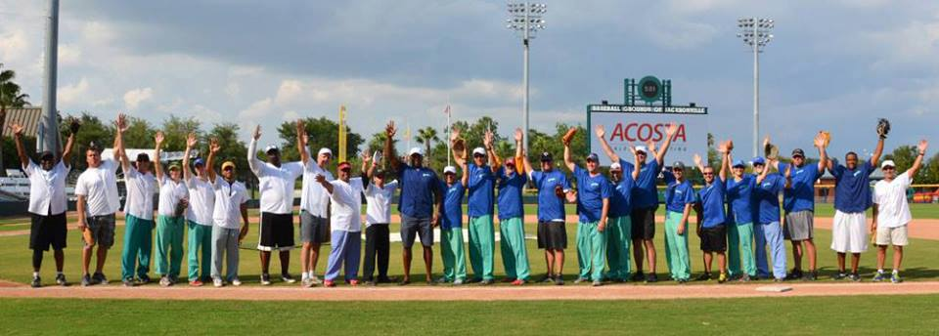
ROUNDS AT THE GROUNDS
Northeast Florida Healthy Start Coalition

Slide 2
The Beginning of an Era!
4th Annual The Rounds at the Grounds Event
Event Highlights
Donor Development
Collateral and Promotional Upgrades
Media Coverage
Recommendations for 2014

Slide 3
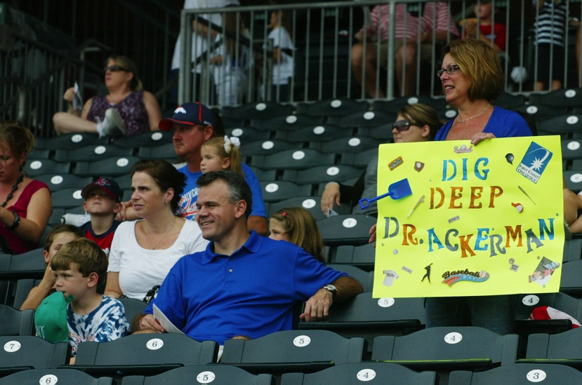
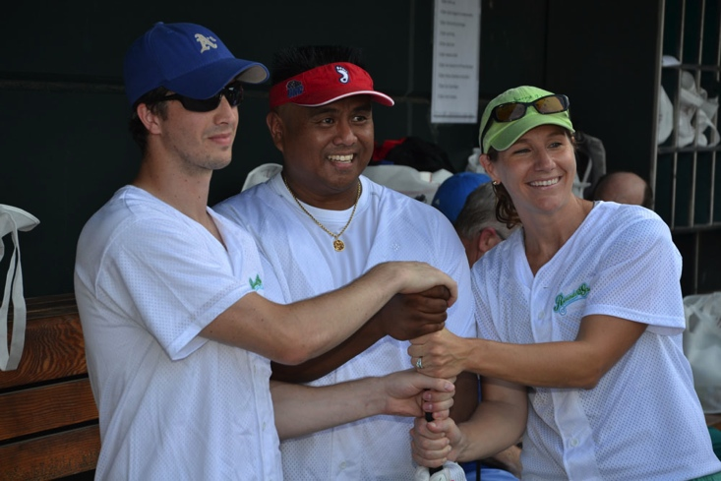
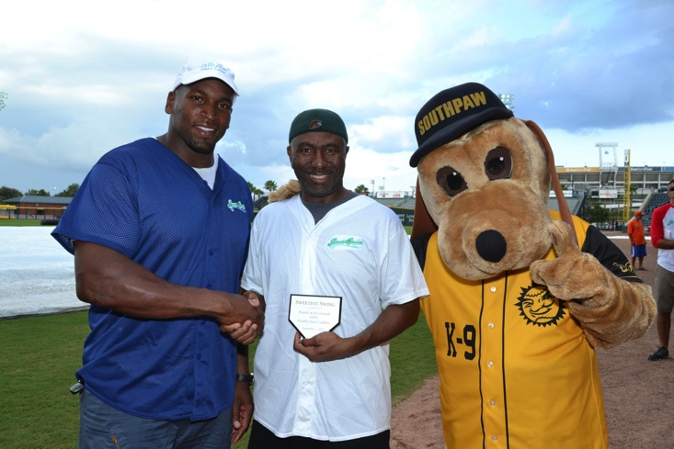
Rounds at the Grounds, The Beginning of an Era!
Now in its 4th year, Rounds at the Grounds is an exciting community event to engage area companies, their employees as fans and volunteers, area health care facilities and baseball fans!

Slide 4
Rounds at the Grounds, The Beginning of an Era!
“The Beginning of an Era,” celebrates the great work of the Northeast Florida Healthy Start Coalition’s efforts over the past 20 years.
Rounds at the Grounds, “The Beginning of an Era” received $35,550 through sponsorships.
Chartrand Foundation matching funds will increase funds raised to at least $71,100.
Expenses came in nearly $10K less than 2012.
2013 saw highest net return of profits compared to 2011-12.
Event received expansive pre-event and day of event media coverage, including television, radio, billboard, on line and print.

Slide 5
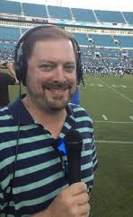
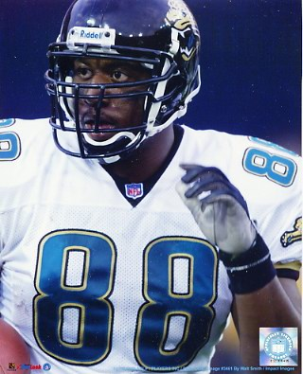
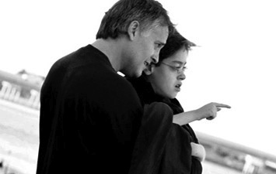
Rounds at the Grounds, The Beginning of an Era!
Jaguars Join the Game!
Mike Hollis, Damon Jones, Paul Frase, Tom McManus, Todd Fordham, Pete Mitchell and Dave Widell!
Former Jacksonville Jaguars from the 1996 “Cinderella Season” joined the teams as celebrity players
Former Jaguars announcer Cole Pepper, News Anchor Melanie Lawson and TV Personality Al Emerick provided color commentary as well as inserting memorable highlights from the 1996 season.

Slide 6
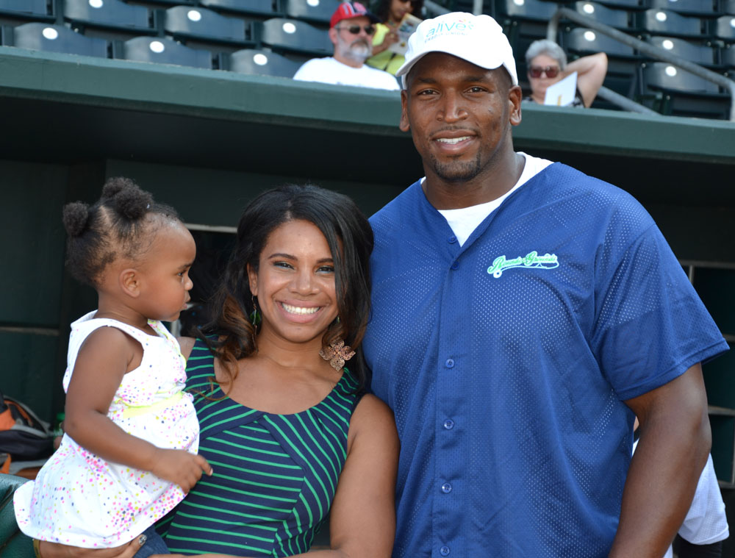
Rounds at the Grounds, The Beginning of an Era!
Jacksonville Jaguars Eugene Monroe served as the lead sponsor and Celebrity Event Host. His wife Nureya sang an amazing National Anthem!
“I am a father myself and my wife and I know how important it is for parents to be given the right tools and education so they can have a healthy and happy baby.” “I am looking forward to being a part of this event again and am excited for another great match up on Bragen Field.” – Eugene Monroe

Slide 7
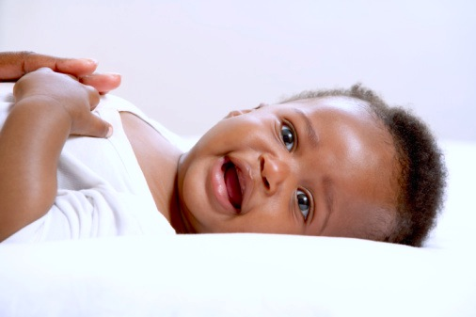
Rounds at the Grounds, The Beginning of an Era!
The Northeast Florida Healthy Start Coalition Donor Cultivation

Slide 8
The Coalition’s Donor Development
A full review was done of past sponsors and donors over the three years of history.
A list of more than 80 companies was compiled for solicitation. Initial outreach began on June 14th.
13 company sponsorships and 10 private donations for a total of $35,550.
Eugene Monroe was again title sponsor for $10,000.
The Healthy Start staff now has a fully operating donor tracking system that can and should be utilized year round until a software solution can be implemented.

Slide 9
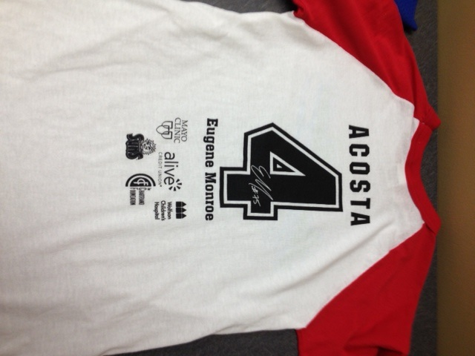
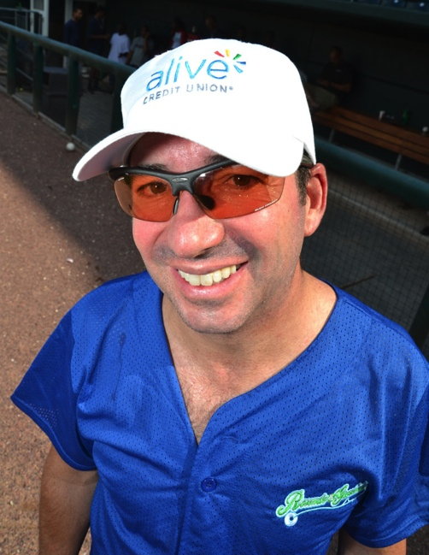
New Sponsorship Opportunities
Created Exclusive Volunteer Jersey Sponsorship (Acosta)
Created Exclusive Hat sponsorship (Alive Credit Union)
These new sponsorships both covered the costs of these items and assisted in developing a new relationship with Alive Credit Union.

Slide 10
Rounds at the Grounds, The Beginning of an Era!
Collateral and Promotional Material Upgrades

Slide 11
Collateral and Promotional Material
Designed new look to RATG logo and collateral to reflect “Beginning of an Era,” vintage theme.
Program reduced in size, pages decreased, ads limited to sponsors. (Substantial cost savings)
Swag bags saw big improvement this year. Items provided by sponsors and donated gift cards to local establishments.
Additional cost savings by repurposing Baseball themed swag bags and promotional fans from previous events.

Slide 12
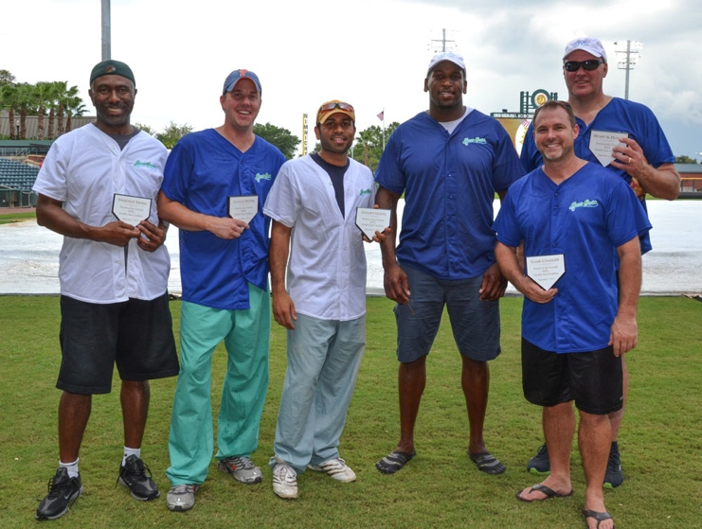
Collateral and Promotional Material
Upgraded player's shirts to uniforms with embroidered RATG logo. The back had their names and title sponsor logo.
Participants thrilled with upgrade and shirts photographed bold and bright.
Fan gift was a soft logoed baseball, signed by Jaguar players at the VIP celebration.

Slide 13
Rounds at the Grounds, The Beginning of an Era!
Media Coverage and Brand Exposure

Slide 14
Media Coverage and Coalition Brand Exposure

Slide 15
Hitting a Home Run in 2014!
Suggest “All Stars” theme. Bring in a variety of local sports celebs in the world of golf, tennis, swimming, etc.
Suggest Meet & Greet event prior to the game for players, sponsors and board members to gather before game begins
Include a VIP spectator seating area for families of Healthy Start to encourage participation
Recommend post event lunch or pizza recognition party for volunteers
Develop a strategic plan to sell game tickets/build fan base, recommendation to include church and volunteer groups (Junior League, Rotaract Club, etc.)
Create incentive to engage board members to attend event and assist in promoting ticket sales

