Slide 1
The BrdsNBz for the Digital Age
CityMatCH Sept. 2013
Bringing Sexual Health Information to Adolescents through Text Messages
Erin Petrie & LaRonda Howard, MPH

Slide 2
Adolescent Health & MCH
NEFL Healthy Start Coalition is a regional non-profit focused on reducing infant mortality and improving birth outcomes
Addresses pregnant adolescents through case management services
But our teen moms are having premature, low birth weight babies and experiencing both fetal and infant deaths at a higher rate than older mothers
Prevention is key!

Slide 3
Adolescent Health in NE Florida
Above the state and national rates of teen births, STIs, sexual activity
Limited access to teen-friendly health care services
Limited comprehensive sex education
Schools focus on abstinence-based education
Teens aren’t having “the birds and the bees” talk with their parents

Slide 4
Teen Birth Rate, 15-19 Year Olds US, Florida & NEFL 2010-2012
Source: Florida Department of Health (FL & NEFL) & CDC (US), 2010-2012

Slide 5
Bacterial STI Rates, 15-19 year olds, Florida & NEFL 2012
Source: Florida Department of Health, 2012

Slide 6
Ever had sexual intercourse, HS Students, US, Florida & Jacksonville 2011
Source: Florida Department of Health (FL & NEFL) & CDC (US), 2011

Slide 7
Sexual Activity, HS Students, US, Florida & Jacksonville 2011
Source: Florida Department of Health (FL & NEFL) & CDC (US), 2011

Slide 8
Identifying strategies
In 2010, the NEFL Healthy Start Coalition convened a Teen Pregnancy Task Force to address the issue and find local and national best practices around adolescent health
BrdsNBZ, a text message program launched in 2009 in North Carolina, was one best practice identified and included in the Task Force’s community action plan
2011 BrdsNBz National established – ‘Call Center’ model

Slide 9
Adolescents & Mobile Phones
75% of all teens ages 12-17 have access to a mobile phone
Mobile phone use is relatively consistent across the board
There is no difference in mobile phone ownership across race/ethnicity and gender;
Lower-income youth less likely to use a mobile phone – but 3 out of 5 still have a cell phone
Kachur, R., Mesnick, J., Liddon, N., Kapsimalis, C., Habel, M., David-Ferdon, C., Brown, K., Gloppen, K., Tevendale, H., Gelaude, D.J., Romero, L., Seitz, H., Heldman, A. B., Schindelar, J. (2013). Adolescents, Technology and Reducing Risk for HIV, STDs and Pregnancy. Atlanta, GA: Centers for Disease Control and Prevention

Slide 10
BrdsNBz NE Florida
The BrdsNBz text line is a free, anonymous
service for 12-18 year olds in Northeast Florida
Am I ready for sex?
Am I normal down there?
You’ll get a personal, medically accurate
Answer within 24 hours!
1.Text NEFLTeen to 66746 to opt in
2.Text your question to 66746
3. Get answered within 24 hours
Get the right information about sexual health.
BrdsNBz™ is a public-private partnership between APPCNC & OneSeventeen Media/KidThrive.org

Slide 11
So how does it work?
Text “NEFLTeen” to 66746 to opt in to the service
Teens text sexual health questions anonymously
Text answered by a certified health educator
Personalized response within 24 hours or sooner (amount of time depends on the complexity of the question)

Slide 12
The average response time for BrdsNBz NE Florida ranges from 54-80 minutes.

Slide 13
BrsdNBz NE Florida Utilization
177 texts
36 follow-up questions or texts
The youth are able to have a “conversation” with the health educator

Slide 14
3pm-6pm was the most popular time for texts
Twenty percent (20%) of all texts were received between 9pm and 3am
This unusually high frequency of “night-time utilization” could indicate that adolescents are seeking information during unsupervised times when they might be making decisions about risky behavior

Slide 15
Questions by Topic

Slide 16
Examples of Questions
How do I know if I got my period?
Development
HIV
Sexuality
Sex
Can I contract HIV through unprotected oral sex?
Is being a lesbian bad?
Am I ready for sex?

Slide 17
The variety of questions demonstrates that NEFL youth need information on a diverse set of questions.

Slide 18
The high night-time utilization underscores the need to opt-in youth to the service whenever we get the chance – to allow them to use it when they need it the most.

Slide 19
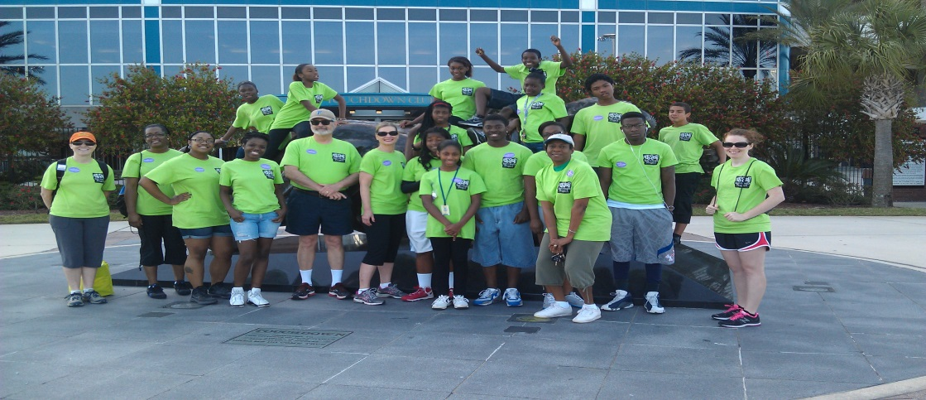
Marketing Tools Utilized
Cards
Pens
Posters
Flyers
T-Shirts
Social media
Media outlets

Slide 20
BrdsNBz Promotion
We distribute information at our monthly partner meetings and at community events/meetings.
Facilitators assist teens in our program with opting-in to the service.
Community partners help promote the program at various community events and meetings.
Our teen leaders promote the service to their peers and friends.

Slide 21
Let’s Try it!

Slide 22
Future Marketing Strategies
TLC PSA Contest
Display Boards

Slide 23
Questions?
Visit http://www.brdsnbz.org for more information.

