Slide 1

Northeast Florida FIMR Findings
January 2012-December 2012
Laurie Lee, RN, BSN, CCM
FIMR Coordinator

Slide 2
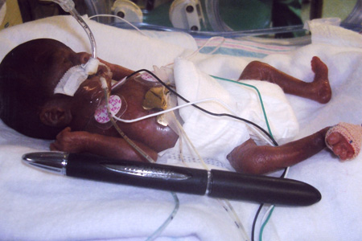
Overview of the Fetal & Infant Mortality Review Process
The FIMR Case Review Team meets 9x/year.
Review process developed by the American College of Obstetrics & Gynecology is used.
Information abstracted from birth, death, prenatal care, Healthy Start, WIC, hospital and autopsy records.
Efforts are also made to interview the family.
All information is de-identified.
Purpose is to determine specific medical, social, financial and other issues that may have impacted the poor birth outcome.
Recommendations for community action drafted annually based on findings.
Prepared by Llee
NEFL FIMR
Healthy Start Coalition

Slide 3

Overview of the Fetal & Infant Mortality Review Process
The purpose of FIMR is to examine cases with the worst outcomes to identify gaps in services that might be addressed through community action.
Cases selected for review based on specific criteria such as:
  Zip codes with high infant mortality rates
  Fetal losses over 36 weeks gestation or 2500 grams
  Deaths in outlying counties, etc.
Prepared by Llee
NEFL FIMR
Healthy Start Coalition
Notes:
Basically, we are looking for cases where we might have an impact on the outcome.

Slide 4
Florida
Infant Mortality Rate Trends
Florida, 1990-2012

Slide 5
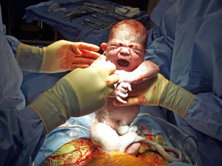
Resident Infant Mortality Rates-All Races
Northeast Florida and Florida
2003-2012
127 infant deaths in 2012
Prepared by L.Lee Source: Birth and Death Certificates/Vital Stats

Slide 6
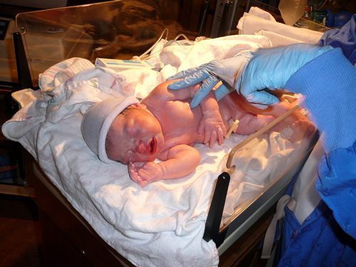
Resident White Infant Mortality Rates
Northeast Florida and Florida
2003-2012
51 white infant deaths in 2012
Prepared by L.Lee Source: Birth and Death Certificates/Vital Stats

Slide 7

Resident Black Infant Mortality Rates
Northeast Florida and Florida
2003-2012
67 black infant deaths in 2012
Prepared by L.Lee Source: Birth and Death Certificates/Vital Stats

Slide 8

5 Year Infant Mortality Rates
Outlying Counties
2008 – 2012
 | Infant Deaths | Births | IM Rate
Baker | 20 | 1809 | 11.1
Clay | 58 | 10789 | 5.4
Nassau | 27 | 3886 | 6.9
St .Johns | 38 | 9091 | 4.2
Prepared by Llee
NEFL FIMR
Healthy Start Coalition
Notes:
8
Duval-538 deaths and 64,099 births. For the entire death cohort, the following trends are noted by county:
Baker-highest single moms, poor birth spacing, congenital anomalies and mom’s with no HS diploma. Clay-highest unhealthy BMI, highest hispanic rates and second highest for teenage moms. Nassau-Highest white, 2nd to baker for no HS diploma, highest substance abuse (tobacco), and large # of mom’s with overweight or obese pre-pregnancy BMI’s. St. Johns-2nd highest white, highest married, highest w/ some college, best in pnc, birth spacing and health BMI’s, but do have largest number of mom’s with underweight BMI’s, highest cocaine use and more fetals than infants.

Slide 9
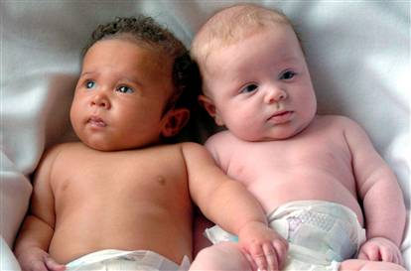
Resident Infant Mortality Rates by Race
Duval County
2007-2012
Prepared by L.Lee Source: Birth and Death Certificates/Vital stats
104 deaths:33-W; 64-B; 21-T
Notes:
Target area in 2005 was 20.1, black rate was 16.9.

Slide 10
Duval County
White Births
2007-2012

Slide 11
Duval County
Black and Other Births
2007-2012

Slide 12
Birth versus Death Cohorts: Demographics
 | Birth Cohort | Death Cohort
Race | W=54%; B=36% | W=33%; B=60%
Age | Teens trended down over last 3 yrs, currently about 8%; 20-29 year olds represent 56-59%; slightly higher % of mom’s in 30’s | Very similar to births; slightly higher % of mom’s in 40’s
Single Marital Status | 48% last 5 years | Decreased from 65% to 57% last 5 years
Education-HS or higher | 85% | Averaging about 70% last 3 years

Slide 13
Birth versus Death Cohorts:
Behavior
 | Birth Cohort | Death Cohort
Smoking | 8% | Trend down 17 – 12% over last 4 yrs
Unhealthy BMI | 46-51-53% last 3 years | 52-61-56% last 3 years
Inadequate prenatal care | 24% | Trending down over last 5 yrs-40 to 33%
Pregnancy Interval < 12 mos | Trending down16-14% last 6 years | Trending down 22-14% last 6 years

Slide 14
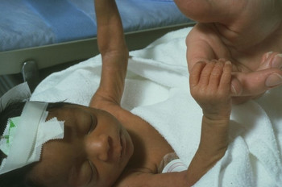
Infant Age at Death
Northeast Florida
2007-2012
Notes:
55% postneonatal deaths are sleep related.

Slide 15
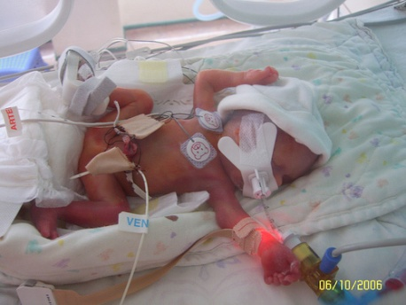
Causes of Infant Death
Northeast Florida
2012
*records may have more than one cause of death listed n=127

Slide 16

Birth Weight in Infants That Died
Northeast Florida
2012-n=127
68% of the babies that died weighed < 3.3 pounds at birth-up
From 57% in 2011
Notes:
17% twins or triplets; 32% previable (< 500 grams AND < 24 weeks); 61% gestational age < 29 weeks

Slide 17


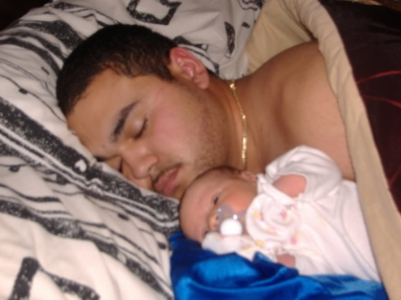

Northeast Florida
Sleep related deaths

Slide 18
Total Number of Sleep Related Deaths
Northeast Florida
2007 – 2012
 | 2007 | 2008 | 2009 | 2010 | 2011 | 2012
# | 27 | 27 | 22 | 16 | 14 | 21
% of deaths | 17.6% | 16.4% | 15.1% | 12.6% | 12.9% | 16.5%
Prepared by Llee
NEFL FIMR
Healthy Start Coalition
Notes:
18
Decrease in # cases with SIDS listed as COD since changes in death scene investigation. No SIDS in 2012. 10 Undetermined after autopsy; 10 SUDI and 1 overlay.

Slide 19
Distribution of Sleep Related Deaths in 2012
 | Baker | Clay | Duval | Nassau | St Johns
# deaths | 0 | 3 | 17 | 0 | 1
Duval county detail:
In 2011, there was only one zip code with more than 1 sleep related death (32206)
In 2012, several zips had more than one sleep related death; 7 were in target area alone in 3 zips. Other zips with > 1 are 32218 and 32244.

Slide 20

Risk Factor Comparison
Risk Factor
Unsafe sleep surface | 80%
Not on back to sleep | 66%
Not in an infant bed | 69%
Never breast fed | 66%
Unsafe items in bed | 60%
Second/third hand smoke | 46%
Sharing sleep surface | 55%
Prepared by Llee
NEFL FIMR
Healthy Start Coalition
Notes:
All factors fairly consistent over last several years, but did see decrease in bedsharing. For 2012, 38% with co-sleeping listed in COD, but death scene investigation sheets not available as they have been in past years so actual number of cases where co-sleeping was involved is most likely higher.

Slide 21


Maternal Findings
Sleep Related Deaths-2012
76% in their 20’s and single
½ black; all others white except one multi-race
71% inadequate prenatal care
38 % with no high school diploma
42% are overweight or obese; only 1 of these involved co-sleeping

Slide 22
Infant Findings
Sleep Related Deaths-2012
All singletons except one twin sharing sleep surface with sibling
90% Medicaid
85% term
57% male

Slide 23
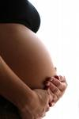
Contributing Factors in FIMR Cases
2010-2012
N=81
78% all FIMR cases had med hx issues
Notes:
There were medical history issues in 78% of all FIMR cases.

Slide 24

Contributing Factors in FIMR Cases
2010-2012
N=81
Prepared by L.Lee Source: FIMR/CRT case reviews

Slide 25
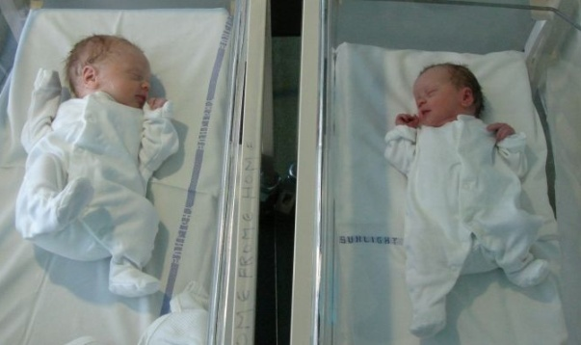
Contributing Factors in FIMR Cases
2010-2012
N=81
Prepared by L.Lee Source: FIMR/CRT case reviews
Prepared by L.Lee Source: FIMR/CRT case reviews
Notes:
Over last 4 years, poverty has ranged from about 25% to 55% of FIMR cases. Emotional Stressors have increased in frequency from about 18% to about 41%.

Slide 26
Contributing Factors in FIMR Cases
2010-2012
N=81
Prepared by L.Lee Source: FIMR/CRT case reviews
Prepared by L.Lee Source: FIMR/CRT case reviews
Notes:
PROM, Anemia and Placental Abruptions occurred in a little over ¼ of the FIMR cases. STD’s have risen steadily over last 3 years…now down slightly in FIMR cases, but still in 1/3. 16% of cases indicated mom had either too much or too little weight gain during pregnancy to the point the the CRT felt it was a contributing factor to the poor birth outcome. Of those, 2/3 were too little weight gain or actual weight loss during pregnancy.

Slide 27

Contributing Factors in FIMR Cases
2010-2012
N=81
Prepared by L.Lee Source: FIMR/CRT case reviews
Prepared by L.Lee Source: FIMR/CRT case reviews
Notes:
Late entry into care increased from a little under 20 percent to about 43% in FIMR cases last year, now is 53%. Nearly 1/3 of the cases w/ family planning issues (25% of entire 81 FIMR cases) had < 12 months birth spacing; 75% were unplanned pregnancies.

Slide 28

Contributing Factors in FIMR Cases
2010-2012
N=81
Prepared by L.Lee Source: FIMR/CRT case reviews
Prepared by L.Lee Source: FIMR/CRT case reviews

Slide 29
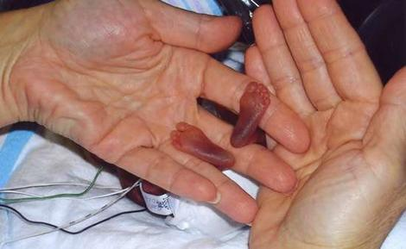
Contributing Factors in FIMR Cases
2010-2012
N=81
Prepared by L.Lee Source: FIMR/CRT case reviews
Prepared by L.Lee Source: FIMR/CRT case reviews
Notes:
Be mindful that COD of prematurity does not apply to fetal deaths; nearly all infant deaths reviewed had prematurity identified as contributing factor.

Slide 30

2013 FIMR Recommendations
(based on 2012 data)
Continue to focus on preventing sleep related deaths.
  Of the 127 infant deaths in Northeast Florida in 2012, 21 were sleep related. This represents 17% of all deaths as opposed to 13% in 2011.
  Focus on safe sleep surface and bed sharing.
  Reconnect with Healthy Moms and Health Babies to revive the Cribs 4 Kids programs in the Northeast Florida region and take advantage of cash matching programs (program was not active in 2012 and thus may have contributed to the increase in deaths).
  New Florida Law effective July 1, 2013, requires all new parents to watch a safe sleep video before
  taking their baby home.

Slide 31
2013 FIMR Recommendations
(based on 2012 data)
Focus on safe sex, STD prevention and family planning.
  Duval County ranks 5th in the state based on 2012 data in STD rates.
  STD protection education should be separate from family planning as the contraceptive methods that are most effective do not protect against STD’s. Clients need to think of both concerns and make decisions about each one individually.
  Within the FIMR cases, STDs during pregnancy increased from 9% in 2009 to 35% in 2011. It was at 23% in 2012.
  83% FIMR cases had family planning issues. 75% unplanned; 25% w/ pregnancy intervals < 12 months. Need to provide early contraceptive education in immediate PP period about choices, options and spacing.

Slide 32
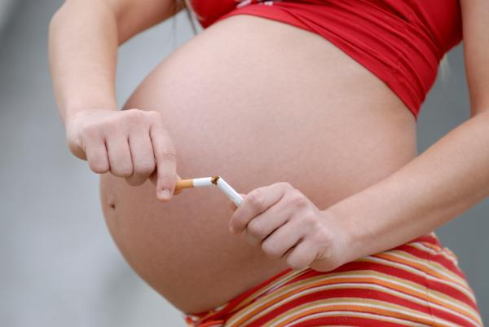
2013 FIMR Recommendations
(based on 2012 data)
Continue to focus on dangers of smoking during pregnancy.
  Over the last 3 years, the percentage of moms in the death cohort that self-reported some type of substance abuse has from 11 to 17%.
  In all years, >90% were tobacco smokers.
  The C.A.T. began an anti-smoking campaign in the target area (Health Zone 1) last year.
    Phase 2 planned this year.
    Focus on social media and expansion to 32218 and 32244 zips.
  The Healthy Start program in St. Johns County piloted SCRIPT (evidence-based smoking cessation program for pregnant women) based on last year’s recommendations.
    Pilot successful; now expanding into all 5 counties.
    All HS providers will be trained in the SCRIPT program.
  All 5 counties have Tobacco Prevention programs w/ FDOH.

Slide 33

Thank you!
Any questions?

