Slide 1
In memory of
Karen Y. Smithson
A tireless advocate for women and children in Northeast Florida

Slide 2
Karen’s life work was dedicated to making sure very baby had a healthy start.
For more than a decade, she ran Hold Out the Lifeline, a community-based initiative that engaged local churches in the effort to reduce black infant mortality.

Slide 3
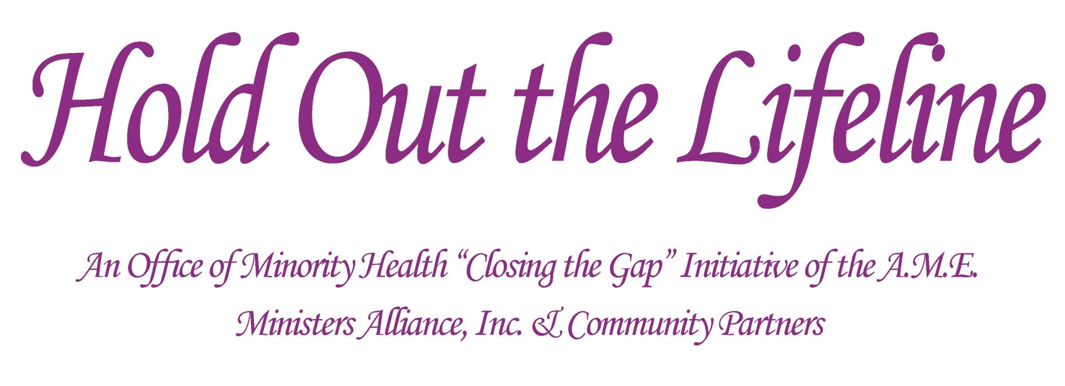
Through Hold Out the Lifeline, Karen touched the lives of countless women, babies and their families.

Slide 4
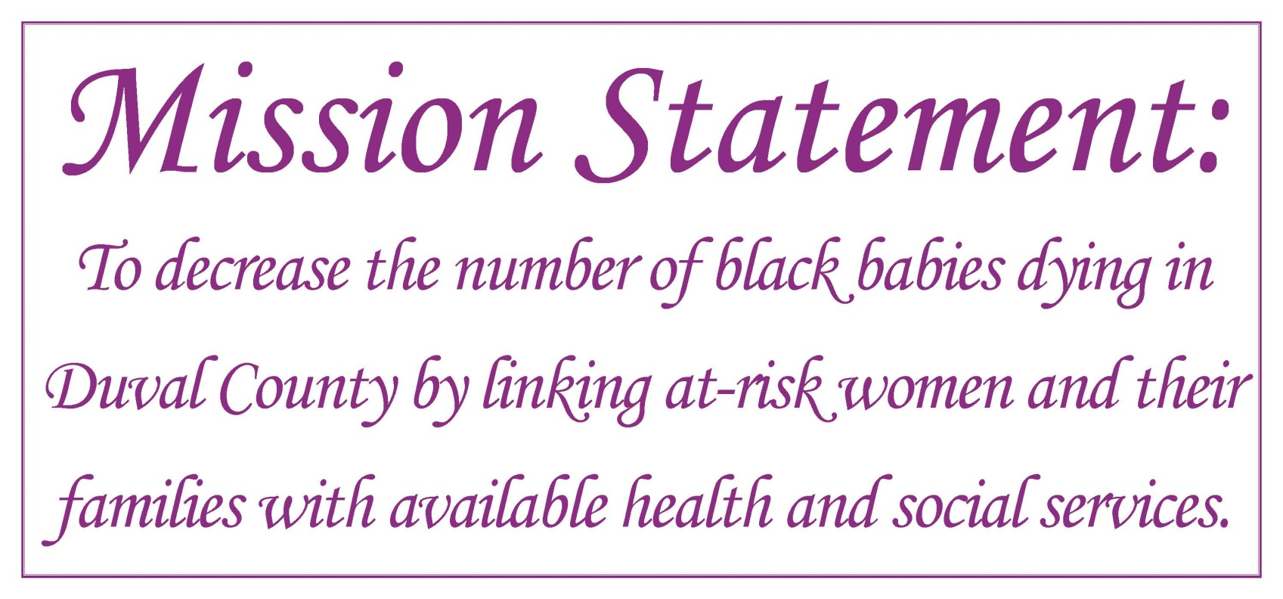

Slide 5

Hold Out the Lifeline
During her tenure with the program, she oversaw numerous community initiatives:
  Lifeline Health Fairs
  Neighborhood outreach
  Body & Soul
  Your Body, Your Temple
  Project Moses

Slide 6
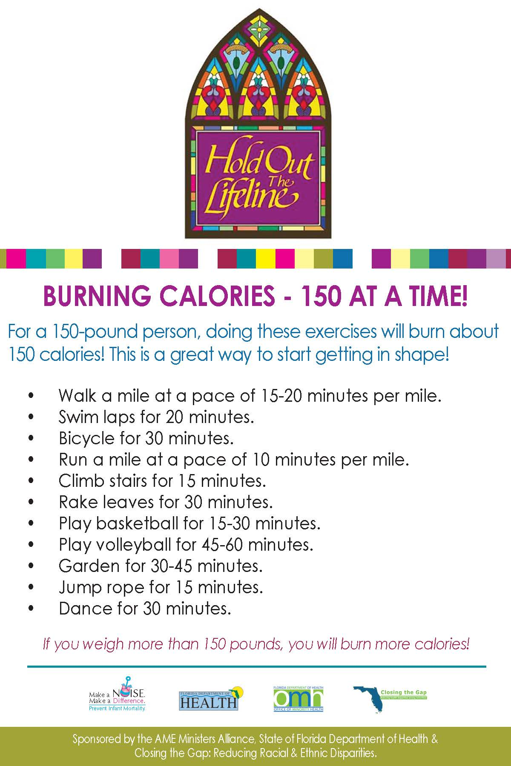


Slide 7
Making a Difference
More than 100,000 one-on-one contacts with mothers and the community as a whole
Recruited, trained and retained over 100 volunteers for community outreach
Sponsored more than 50 Lifeline Saturday events (health fairs) in the Jacksonville
Constructed and distributed approximately 2,000 bassinets

Slide 8
Project Moses
Through Project Moses, a Hold Out the Lifeline initiative, church women crafted bassinets and provided education to families on the importance of practicing safe sleep.
The baskets provided a safe sleep environment for babies and provided an opportunity for the women in the church to learn about safe sleep themselves

Slide 9
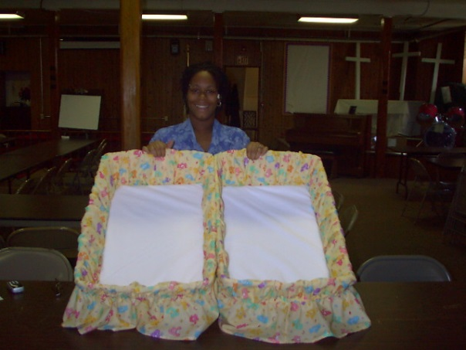
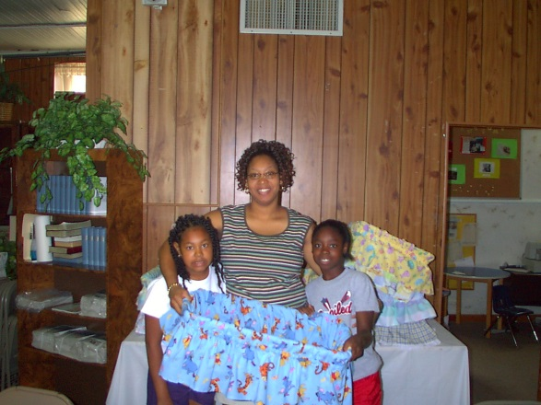
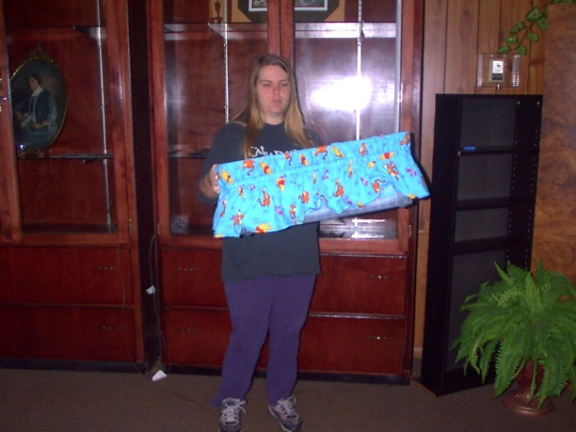
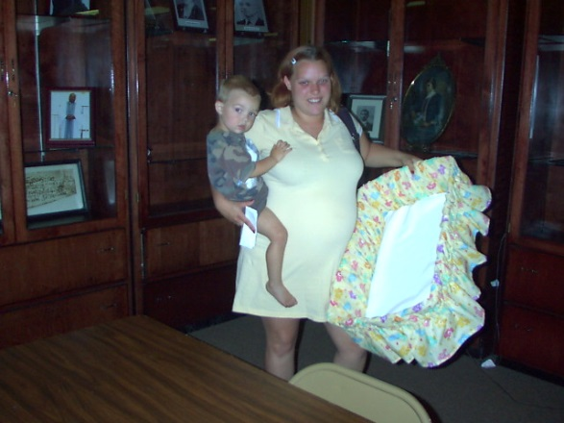
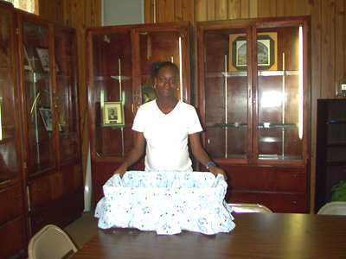
The project allowed families to provide a critical safe sleep environment for their children

Slide 10
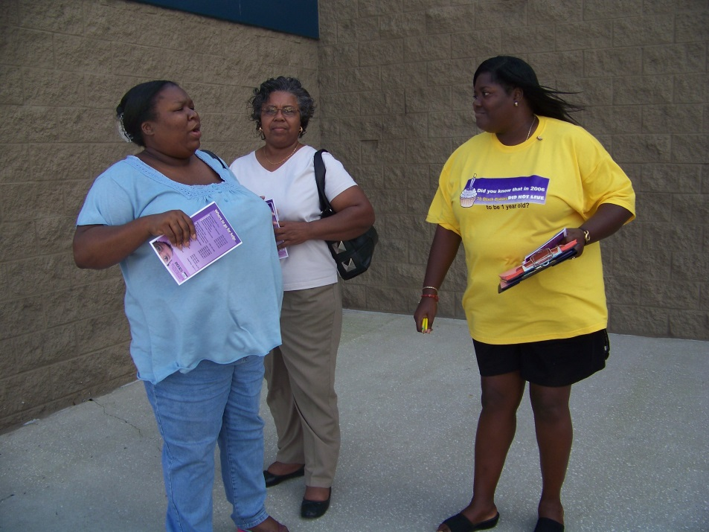
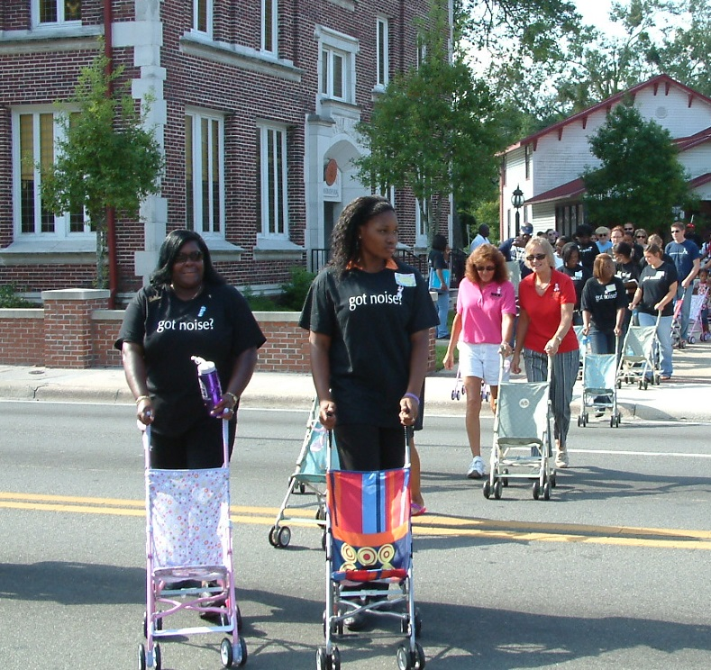
Dedicated
Family Reunion Health Fair & Stroller Walk, 2009
Black Infant Health Community Council Infant Mortality Event, 2008

Slide 11
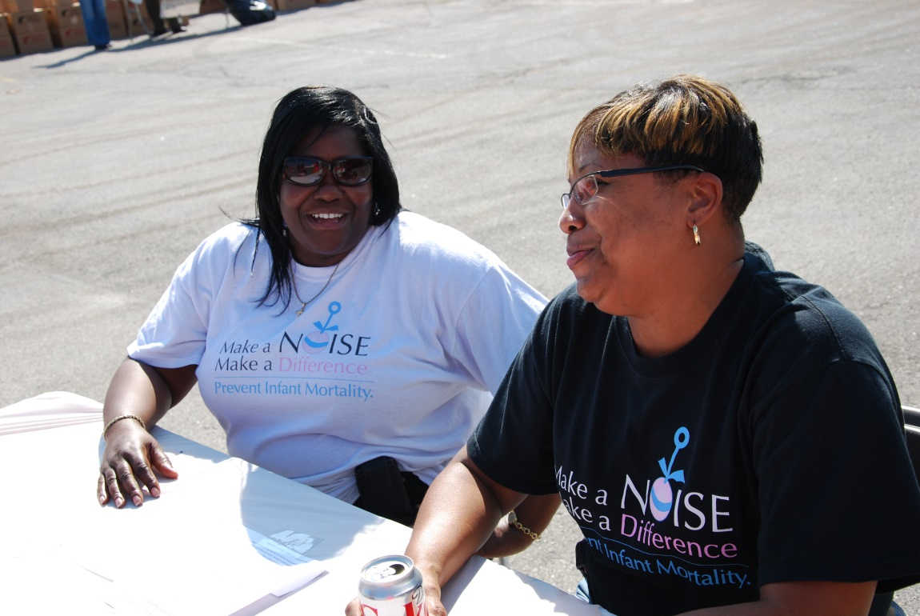
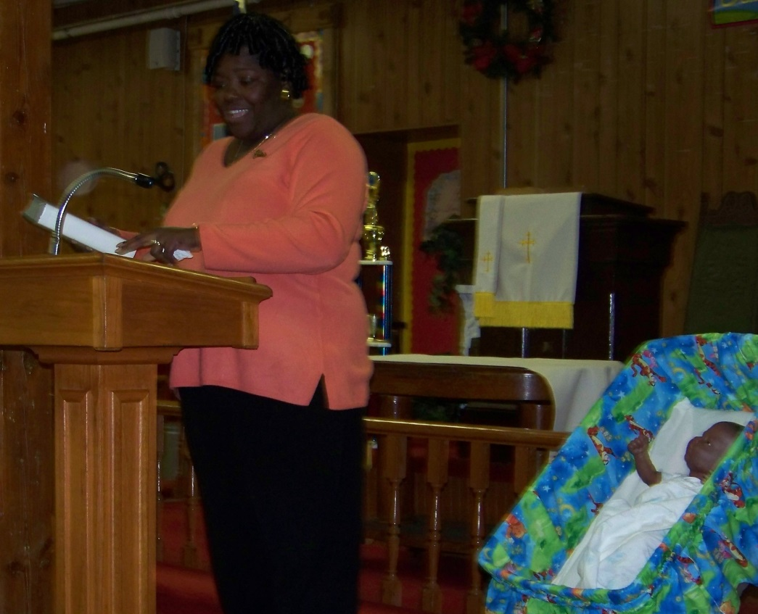
Passionate
Granny Said, 2009
Feed the Children 2011

Slide 12
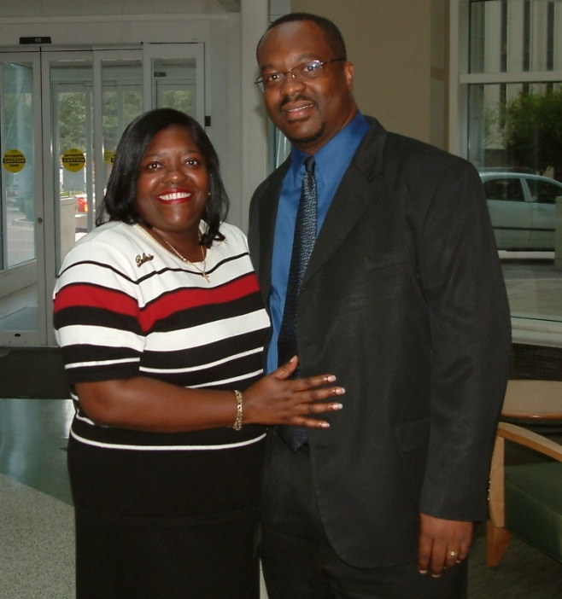
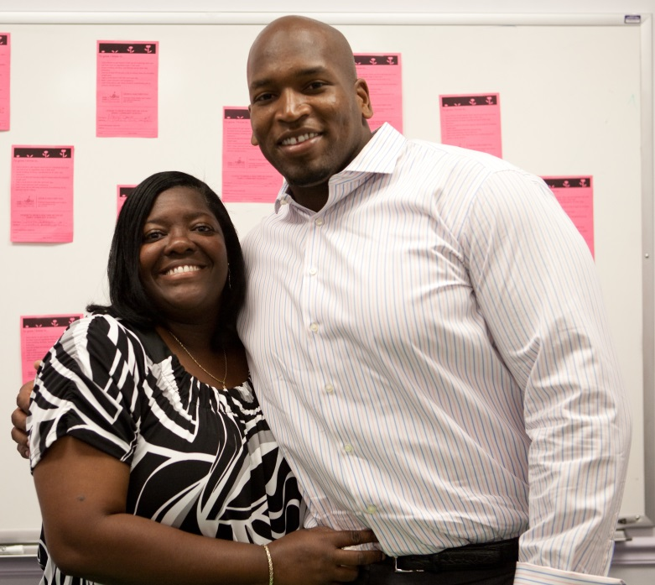
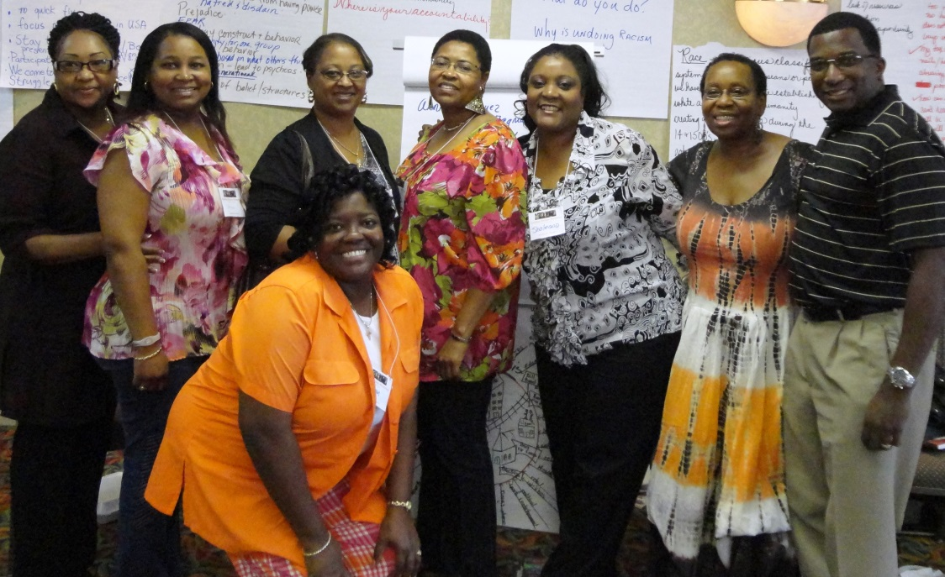
Color our World Reception, 2009
Magnolia Project 10th Anniversary, 2010
Undoing Racism Workshop, 2011

Slide 13
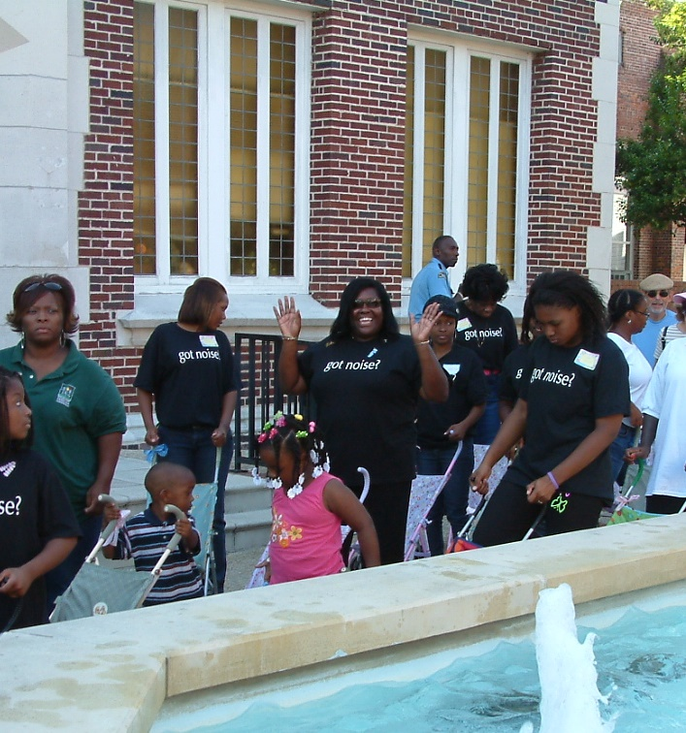
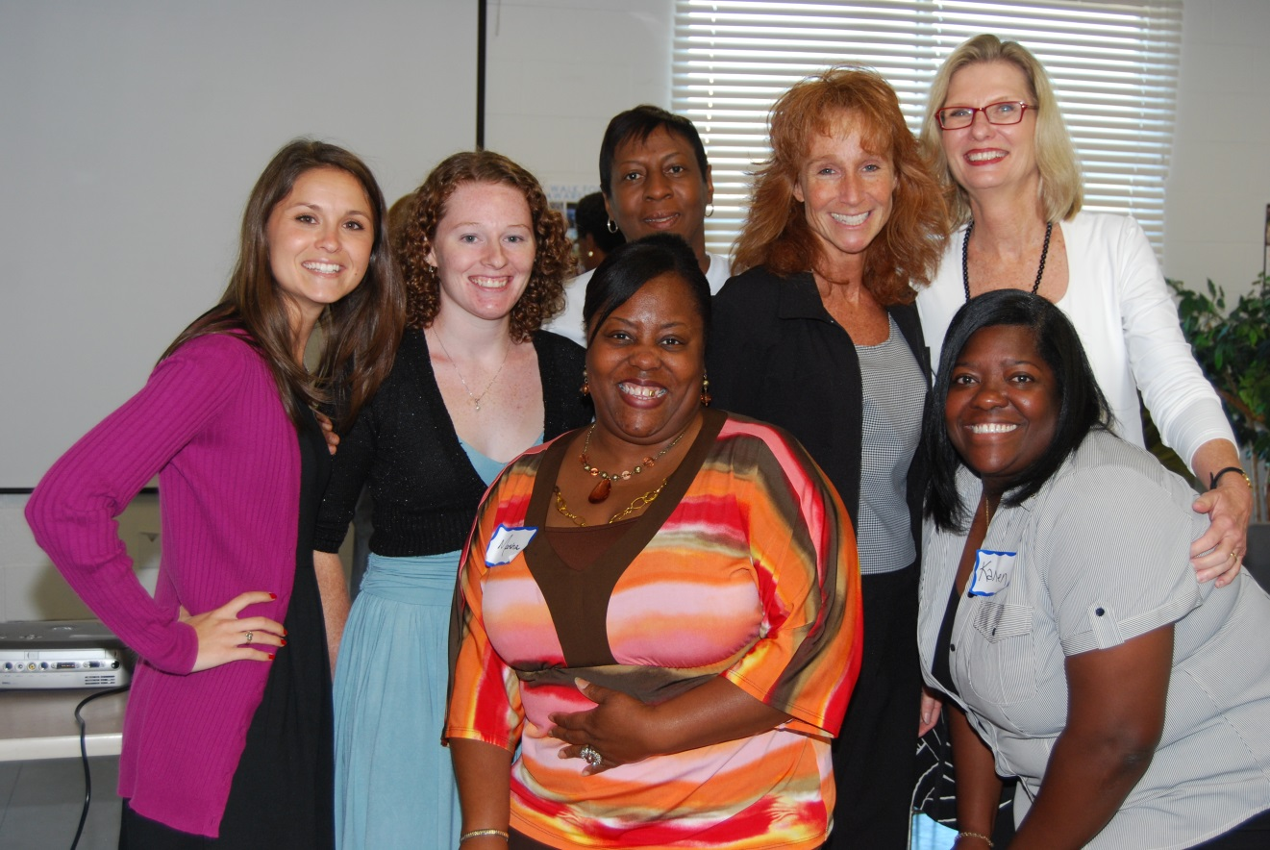
Community Breakfast, 2010
Family Reunion Health Fair & Stroller Walk, 2009

Slide 14
