Slide 1
Yoga in the Street

Slide 2
Mission
To Improve the health and well-being of woman during their childbearing years by empowering communities to address medical, behavioral, cultural, and social services needs.

Slide 3
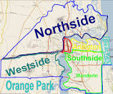
Snap Shot of Jacksonville
Infant mortality rate (2014): 8.8 deaths per 1,000 live births (2005 rate 11.6)
The Magnolia Project located in Jacksonville/Duval County Health Zone1
IM driven by disparities
44% of births were to Blacks & other nonwhites
Blacks historically have poorer outcomes in Jacksonville than in other urban areas of the state
IM rate is slightly 2x higher
than the White rate

Slide 4
Issue: Toxic Stress and Health
Toxic Stress Contributes to poor health. The Magnolia Project provides underserved communities with “Yoga in the Street” to improve health. Wellness can be achieved in the midst of the communities that the Magnolia Project serves.

Slide 5
Yoga in the Street Community Sites
Westbrook Community Center, Hollybrook Apartment Homes, Cleveland Arms Apartments, The Magnolia Office
Heavily influenced by Poor Infrastructure, Poverty, Crime, Substance abuse, Depression and Anger
Components that contribute to
behaviors and mindsets that
overlook health and wellness.

Slide 6
Westbrook Community Center

Slide 7
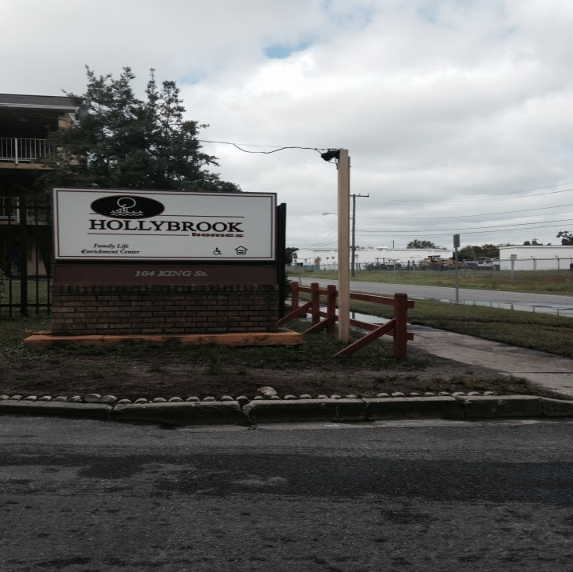
Hollybrook Apartment Homes
Property Management
Rebuilding the reputation of the community
Staff support
Building trust and safety among
residents

Slide 8
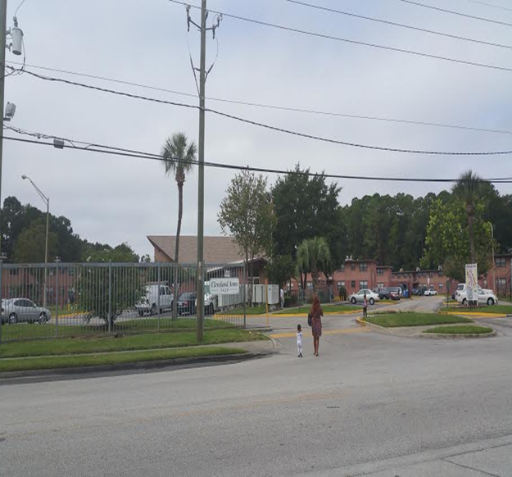
Cleveland Arms Apartments

Slide 9
Issue: Toxic Stress Contributes to Poor Health
Emotionally, Socially, and Physically
Overactive stress response
Poor emotional self regulation
Allostatic Load
Many of us feel stress and get overwhelmed not
because we're taking on too much, but because
we're taking on too little of what really strengthens us.
*Marcus Buckingham

Slide 10
Yoga: A Gateway to Wellness
The Magnolia Project strives to offer a level of service that go beyond the surface needs of our participants.
We utilize the trauma informed care model to help address specific social determinants affecting many participants. Such as; finances, education, poverty, racism, family support and connectedness.
We strive to build social capital and interdependency among the women served by the Magnolia Project.

Slide 11
Partnership and Support
“Yoga can still the mind, instill hope, strengthen our bodies and show us a way forward in our lives.”

Slide 12
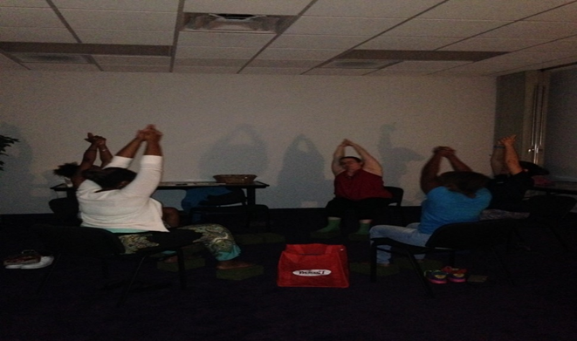
Yoga in the Street Areas of Focus
Access to a wellness Practice: Taming the Stress Response via Hatha yoga, the most common type of yoga practiced in the United States, combines three elements: physical poses, controlled breathing practiced in conjunction with the physical poses; and a short period of deep relaxation or meditation.
Improve Mood: a wide range of yoga practices suggest they can reduce the impact of exaggerated stress responses and may be helpful for both anxiety and depression.
Reduce Blood Pressure Numbers:
There is also evidence that yoga
practices help increase heart rate
variability, an indicator of the
body’s ability to respond to stress more flexibly.

Slide 13
Barriers
Negative stereotypes about yoga
Low self confidence and esteem
Uncomfortable joining group settings
Fear of coming out to the community centers.
Effectively communicating how toxic stress contribute to poor health.
Help the community embrace a more mindfulness state of mind.

Slide 14
A Pleasant Surprise
49 community residents attended the “Yoga in the Streets within a 4 month time period
80% was under the age of 30
Class attendance was on average 3.2 times with several individuals attending over 12 times.

Slide 15
Yoga in the Street Outcomes
Emoji Mood Assessment
Overwhelmed Comfortable Worried Tired Mad Relaxed
90.8% left class with overall positive emotions.
Everyone who came in with a -4 left with a +2 mood change.
Of the people who came in with overall negative emotions, 87.2% left with overall
Positive emotions.

Slide 16
Yoga in the Street Outcomes
60% had a decrease in systolic and 50.7% in diastolic
On average the systolic decreased by 3.65 (mm Hg-millimeters of mercury) and the diastolic decreased by 1.57 (mm Hg-millimeters of mercury).

Slide 17
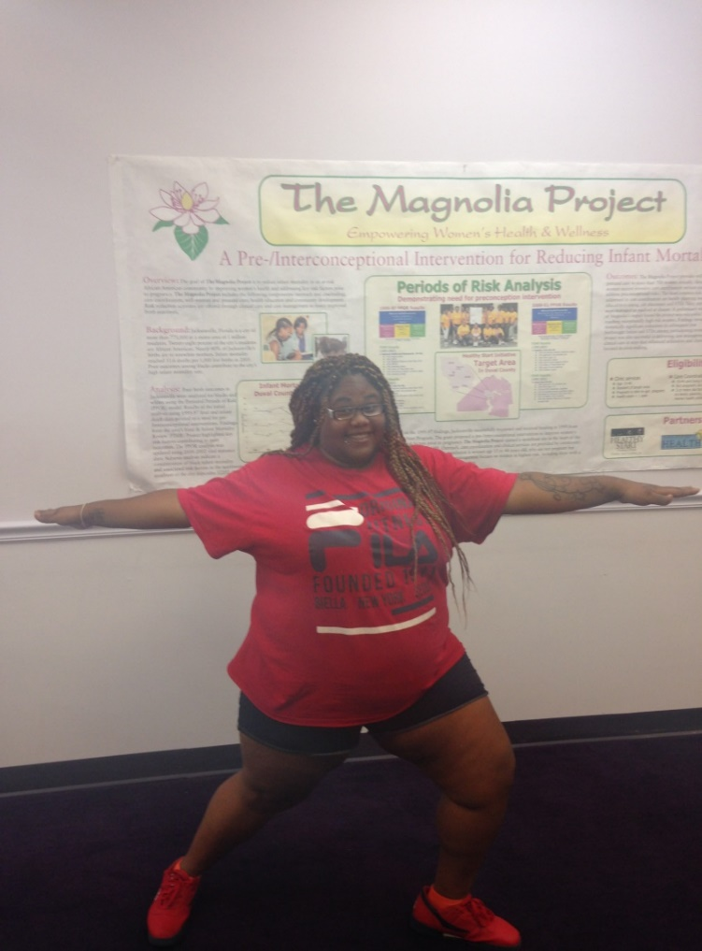
Community Response
Increasing access to wellness practices
Inquiring about additional support via case management.
Increasing movement
Improving self-confidence and self-care (Jennifer-a new mom)

Slide 18
Who is being Impacted?
Children
Families
Participants
The community at large
Community housing
Agencies
The soul within.

Slide 19
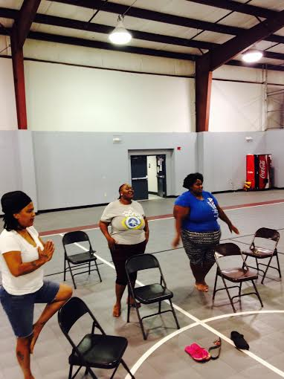
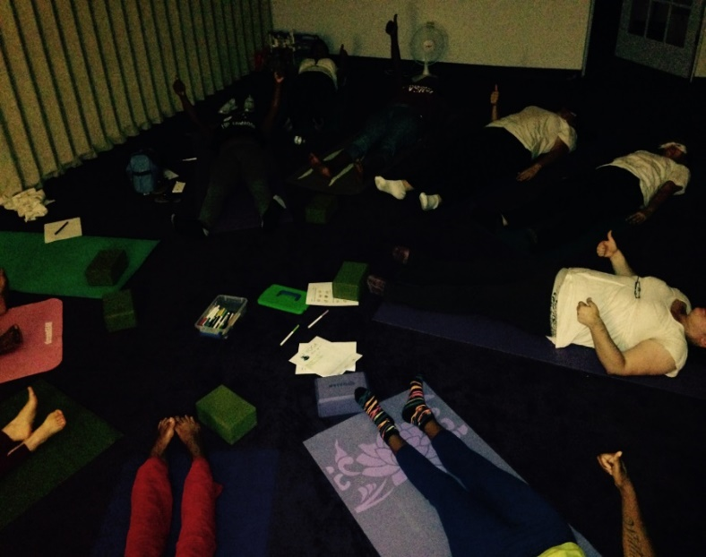
Lessons Learned
The practice of community yoga- Yoga in the Street has the potential to help close the gaps on the components of life that devastate the quality of life: minimal social support, poor self-confidence, minimal regard for the health of the mind, body, and spirit.

Slide 20
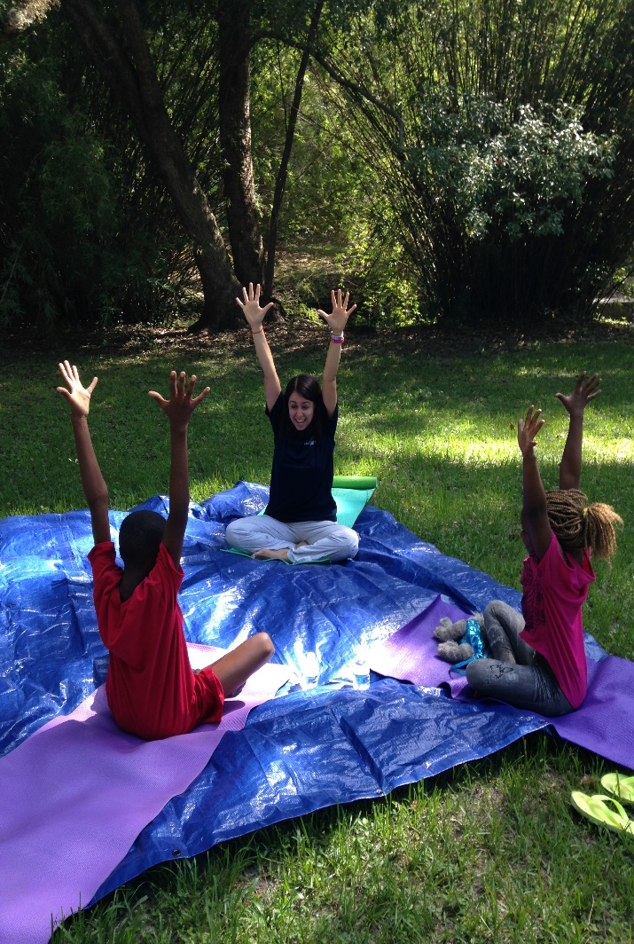
Information for Replication
The Yoga in the Street practice is offered as a part of the Magnolia Project services.
The community yoga practice can be replicated in other programs easily. Collaborate with organizations with expertise in specific area and partner with direct service delivery programs at minimal to no cost.
The Magnolia Project has a vibrant “earn and reward” program.
Most of all Be Creative, Passionate, and move with Purpose and watch the possibilities.

Slide 21
Thank You!
Sabrina Willis, MHC
swillis@nefhsc.org
http://nefhealthystart.org/for-women/magnolia-project/
@nefhealthystart

